Slide 1
Driver’s License for All
&
DVS Language Project

Slide 2
Two important initiatives of the Minnesota Department of Public Safety Driver and Vehicle Services (DVS) division are making interactions with DVS easier and providing services to those who were unable to previously access those services.

Slide 3
Driver’s License for All Removes barriers to legally obtain a standard driver’s license, permit or ID card by eliminating the requirement that the applicant provide proof of legal presence in the United States. Available Oct. 1.
Increases equity and expands access to resources and
services within the community, including work and education.

Slide 4
DVS Language Project A multilingual virtual assistant (VA), leveraging Google artificial intelligence and available now on the DVS website. Makes interacting with DVS better for customers who speak English, Hmong, Somali and Spanish.
VA provides answers to the most common questions DVS receives on any given day. Users can also update their insurance and obtain individualized records.

Slide 5
Why these projects matter
All state residents deserve access to information in a form they can understand.
DVS is only successful if all customers can access and use our services – and appreciate the experience.

Slide 6
Why these projects matter
At DVS, we embrace and appreciate language and ethnicity differences in our required driver and vehicle information processes.
Driver’s License for All increases equity and expands access to resources and services within the community.

Slide 7
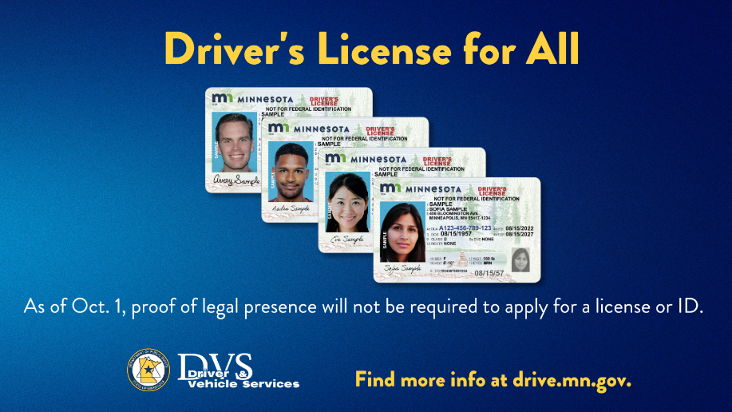
Why these projects matter
Driver’s License for All improves roadway safety because licensed drivers participate in behind-the-wheel training, are familiar with Minnesota driving laws and have demonstrated the skills to safely operate a motor vehicle.

Slide 8
Ready to learn more?
Driver’s License for All:
Go to the Department of Public Safety website (dps.mn.gov). Click the icon in right margin. DVS Language Project:
Go to drive.mn.gov and click on the Help icon (bottom right).

