Slide 1
Public Safety Broadband for the PSAP 2014 Minnesota Public Safety Interoperable Communications Conference
Speaker:
Rick Burke,
Televate, LLC Managing Partner

Slide 2
Agenda
Overview
LTE Overview
Next Generation 9-1-1 Overview
New Era in Public Safety Dispatch
NPSTC BBWB Console LTE Task
Data Impact on Dispatch
In Preparation for the New Environment
Social Media

Slide 3
Entering a New Era in Public Safety Call Taking and Dispatch
Advancement in technologies
NG-911
Mobile CAD applications
Nationwide Public Safety Broadband Network (NPSBN)
Enhanced vendor solutions
911 call management systems
Records management systems
Computer aided dispatch (CAD)
Broadband mobile data
Commercial cellular carriers
Future NPSBN
The new streams of data will impact 911 Call Taking and Dispatch
What impact?
What changes?
How to prepare for the change?

Slide 4
Why Long Term Evolution (LTE)?
Better performance to all previous broadband data standards
Supports data and voice communications over one technology
Public Safety Band Class 14 standardized
Interoperable with commercial cellular LTE networks
Substantial North American and Global adoption
Billions in R&D investments over the next 10 years
The 4+ billion subscribers = potential massive economies of scale
Enhance direct and back-up PSAP communications

Slide 5
LMR and LTE Throughput Pipes

Slide 6
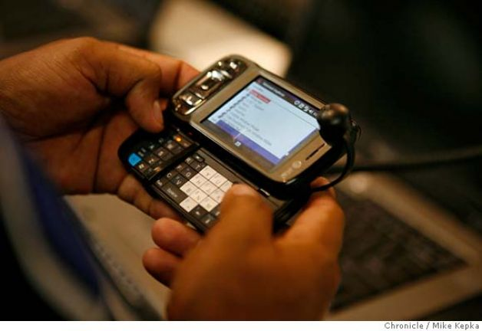
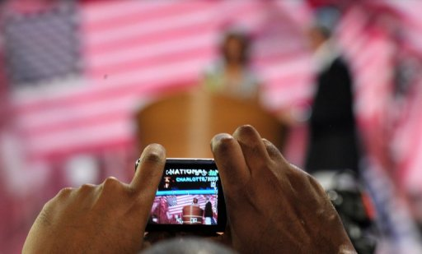
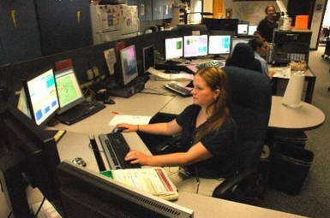
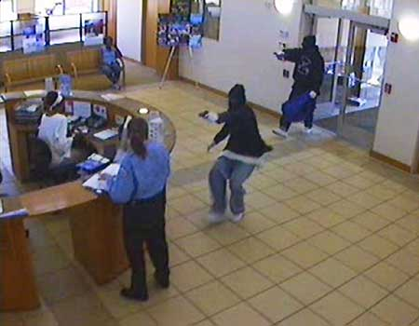
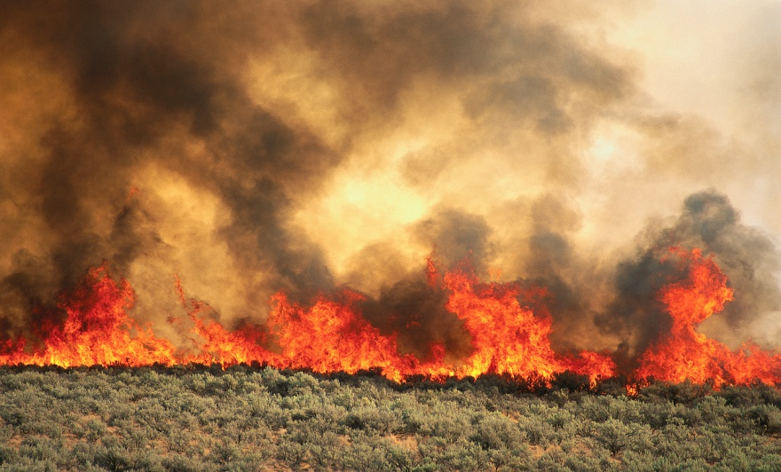
What Next Generation 911 (NG-911) Provides
Equip first observers/citizens
Situational awareness enhancement
Can be delivered directly to first responders in the field

Slide 7
National Public Safety Telecommunications Council (NPSTC) and the BBWG Console LTE Task Group
Guidelines for developing LTE Console Use Cases and Associated Requirements
Think in terms of capabilities that will be present 50 years from now – don’t be constrained by what PS does now, or what consumers do with their smart phones now.
Don’t be constrained by assuming that communications centers and PSAPS will have the same types of equipment in the future. Assume that there will be at the dispatch center one “device”; an “LTE Console” that does it all – call taking, dispatching, CAD, logging, etc.
Focus on the “What” (capabilities), not the “How” (technical solutions).
If a use case becomes large or complicated, break it down into several smaller, simpler use cases.
Alternate flows can include what happens if the network is congested.
Document your assumptions as pre-conditions.
The assumptions section of a use case can identify and assume resolution of policy, governance and procedural issues which might otherwise be a hindrance to actual use case scenarios.
Use cases can be focused by discipline (Fire, EMS, LE), but should take into consideration two other dimensions; size of jurisdiction (rural, urban), and scope of jurisdiction (local, county, state, federal).
Any use case may contain a voice component. Voice does not have to be left out just because mission critical voice will not be part of the initial FirstNet deployment.

Slide 8
BBWG Console LTE Draft Requirements
 | Draft NPSTC Broadband Console Working Group Requirements
1 | Video is monitored at the facility
2 | Receiving voice, video data to the PSAP
3 | Alert to dispatcher that it’s a high-risk facility
4 | Process to filter or select data to send only relevant data
5 | Other data flows will come to comm. Sensor (fire alarms)
6 | Process to organize and prioritize data/information- need to avoid overwhelming PSAP with information
7 | Situational awareness of where calls are coming from
8 | Coordinate among PSAP that will start to get diverted calls
9 | Automated way to off-load calls via geo-fencing (Covered in NG911)
10 | Dispatcher to record automated overcall message management to inform people calling in that PSAP is aware of event. Get a call-back number for new information. Message could be via text.
11 | Data automatically pushed to appropriate first responders based on predefined needs and requirements and certifications.
12 | Some data shared automatically with other PSAPs/disciplines. Need sharing capability so that one person is not overwhelmed
13 | Data must be sorted and forwarded to the correct people.
14 | Bucket data and by protocol certain buckets are available to relevant responders. Allows first responders to “pull” data based on what’s available.
15 | Console must be able to tag and add meta data to incoming data feeds to make it searchable. Need switchboard/analysis beyond automated categorization
16 | Automatic notification to COML and specialized responders is needed.

Slide 9
BBWG Console LTE Draft Requirements
17 | Ability to prioritize access based on need/role.
18 | CAD needs to inform the LTE Network of what is needed for the response to incident. Example- access to incident data based on role.
19 | Dispatcher must be able to receive data from Incident Commander (IC) either automatically or by request
20 | Allow capability and flexibility for PSAP to pull needed data
21 | Process of transitioning certain functions to appropriate on scene management from dispatcher to IC.
22 | Process of transitioning functions from dispatcher to other organizations.
23 | Console must be able to receive video/data feeds as appropriate or needed from incident.
24 | Console will notify user of network overload and lack of availability at the point at which data request is made.
25 | Capability for tactical supervisor to request additional bandwidth. Console ability to assign roles and needs to communicate with LTE Network.
26 | Console communicates user role and resources they get based on role and communicates that back to the LTE system.
27 | Console communicates need for elevated priority and role based on need.
28 | Console can preview, grab, edit, or tag video data within specific parameters.
29 | Console has database of available video cameras and has the ability to choose what camera feeds to watch based on location of cameras.
30 | Console needs capability to discover video streams in area and in building.
31 | Console can access and review stored video and incident data as needed for investigative purposes.
32 | Dispatcher has ability to prioritize and distribute video.

Slide 10
BBWG Console LTE Draft Requirements
33 | Console will view status of incident area network performance
34 | Ability to store incident records.
35 | Vehicle and any UE device should be able to send video and data to console. Example- Video is automatically turned on and automated license plate reader
36 | Variety of standard frames/settings should be available.
37 | Console can control video and data feeds
38 | Console warns dispatcher that there is a high probability to go into neighboring jurisdiction
39 | Console has capability to turn-off in-car data feeds
40 | Console must have voice, video, and data connection between PSAPs
41 | Console needs to support legacy voice and data networks and allow mission critical patching between legacy and LTE networks
42 | Stop stick sensor sends data to console and pushes location information out to other responders
43 | Ability to dynamically share data as units join the incident based on preconfigured rules.
44 | Console should be able to display and filter location information for resources (vehicle, person, animal).
45 | Console should be able to receive location-data time stamp and other meta data initiated by first responder or dispatcher (gun buried at X location).
46 | Console API should be able to interface with multiple systems.
47 | Console should register incident command whiteboard plan
48 | Role-based console view. Console to console synchronized data set.
49 | Console should register when devices go into direct mode.

Slide 11
BBWG Console LTE Draft Requirements
50 | Console receives emergency alerts and overrides D2D settings (if applicable). Alert includes voice, data, etc. Need requirement in UE Section.
51 | Remote console should be able to connect to D2D communications.
52 | Console must be able to accept biometric information alerts.
53 | Console should support and export incident information for reporting purposes
54 | Console should remind dispatcher to check on responder based on a series of parameters.
55 | Console user should be able to activate emergency alert and share information about alert with responding team.
56 | Activate personal alerts for first responder.
57 | Console should be able to connect to a building automation system and control it.
58 | Console must have the ability to integrate with third party applications.
59 | Console must have NG911 features and functionality.
60 | Console must receive and capture data from predefined sensors.
61 | Console must be able to accept reliable feeds and provide confirmation of receiving complete and uncorrupted data
62 | Console needs to be able to go backward and forward through data.
63 | Console needs to provide access control
64 | Console needs to have a security capability to manage traffic between public safety and other networks.

Slide 12
TRANSITION TO NG-911 ENABLES
Quicker receipt of more robust information as the result of making a 9-1-1 call
PSAP receipt of better and more useful forms of information (text, images, and video) from any networked communications device
Transfer of 9-1-1 calls between geographically dispersed public safety answering points (PSAPs)
Increased aggregation and sharing of data, resources, procedures, and standards to improve emergency response
Effective use of available public capital and operating costs for emergency communications services
Promotion of increased coordination and partnerships within the emergency response community
Notes:
12

Slide 13
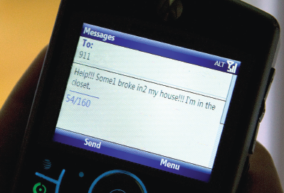
INTEGRATED COMMAND AND CONTROL
Texting to 9-1-1 is achievable via NG-911 and
Valuable opportunities to integrate and share this information within the dispatch environment
Eventually share over FirstNet, commercial cellular for the time being

Slide 14
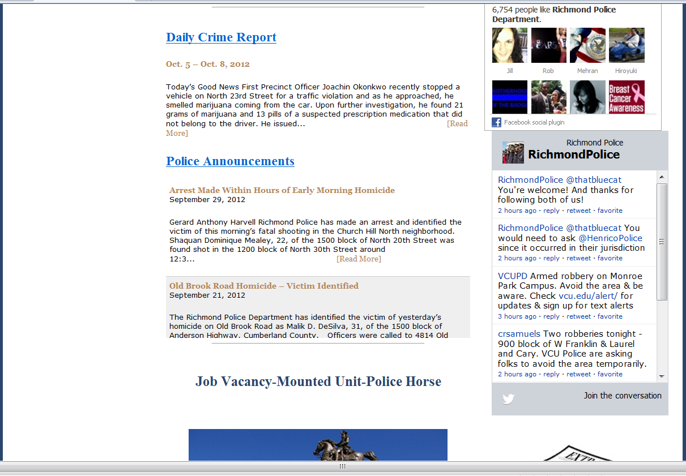
Social Media in Richmond Law Enforcement
Notes:
REAL examples cut and pasted from the Internet last week. Run it in Slide Show mode. Shows the use of Social Media in Law Enforcement – not a stretch at at to NG911 and the impact on dispatch will be great.

Slide 15
Variety of Text Message and Social Media Options

Slide 16
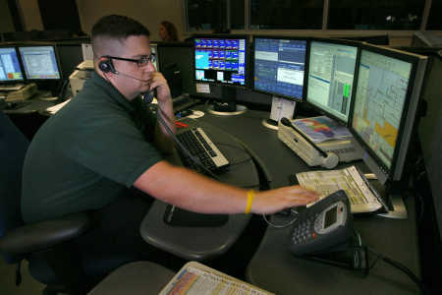
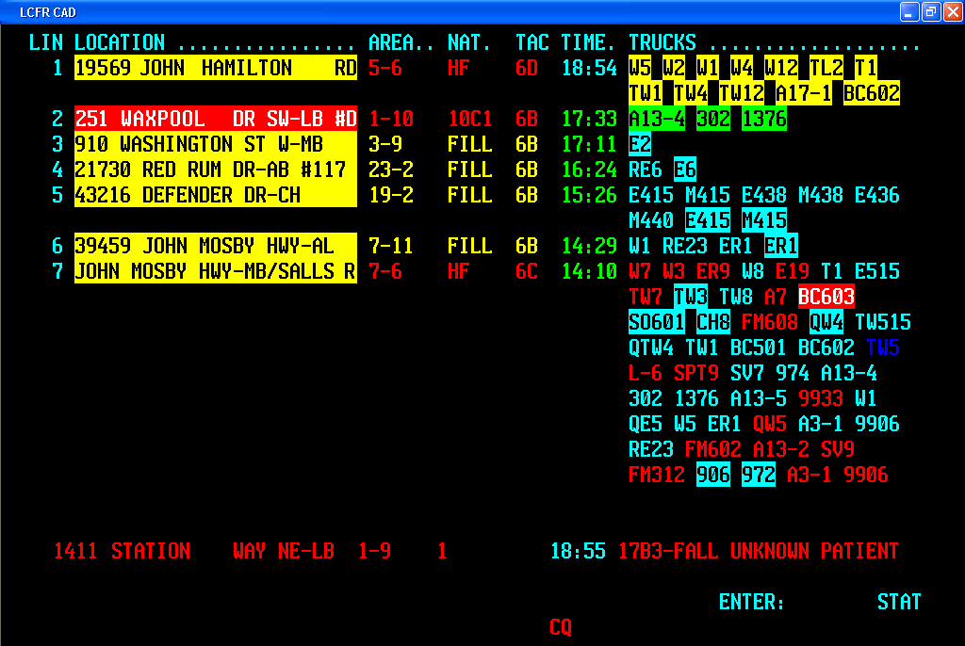
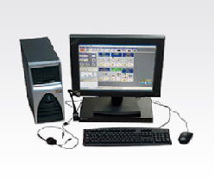
LTE and NG-911 Impact on the Dispatcher
There are three primary components of call taking
and dispatch of impact by enhanced NG-911 and LTE data
Call Taking/Data Delivery | Computer-Aided Dispatch | Communications

Slide 17
Public Safety Broadband Data Applications Survey #1
Devices are moving toward more hand portable devices
Smartphones
Tablets with embedded modems
Preferred Applications
Email/Desktop Extension
Incident Reports (RMS)
Video
Geospatial Data
High Definition Images
Mapping
Telemetry
Incident command

Slide 18
Public Safety Broadband Data Applications Survey #2
Preferred Devices:
PC & Tables with embedded modem or USB modem
Smartphones
Preferred Applications:
Email
Video
High Definition Images
Mapping
Geospatial Data
Telemetry
GIS-based dispatch
Incident command

Slide 19
911 Call Processing and CAD Systems and Solutions
Call processing and CAD systems and solutions must be upgraded to accommodate NG-911 and PS broadband communications
Broadband consoles will be required to support PS broadband communications
Call processing and CAD system upgrades have been initiated by select vendors
Aegis | LEGT
Automated Records Management Systems | ModUcom
BobCOP | Motorola
Communications Electronics | New World Systems
Competitive Edge Software | Siemens
Computer Information Systems, Inc. | Sleuth Software
Dassault | Spillman Tech
Digital FTO | SunGard
Gordon Security Solutions-GSS | Teltronic, Inc
Harris | Tiburon
Infotech Enterprises | Tritech
InterAct | VisionAIR, Inc.
Integraph | Geo Conex
Priority Dispatch | PSSI

Slide 20
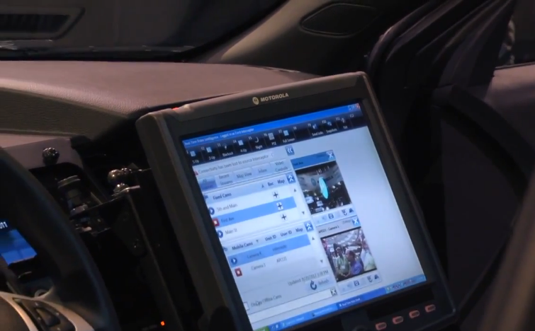
Mobile CAD Applications
Mobile CAD applications are available today from many vendors
Mobile CAD delivered today over commercial cellular networks
Will be delivered over the NPSBN network in the future
Mobile CAD offers significant dispatching options
Provides enhanced field capabilities/situational awareness

Slide 21
How Will Integrated Data Impact the Dispatch Environment
Areas of Impact | Pros | Cons
Call Taking/Data Delivery | Mobile 911 emergency data Robust regional interoperable voice/data messaging w/location Improved information accuracy Workforce efficiencies | Work flow process modification Increased stress: visualize incidents and fatalities Increased call and data management Workload already burdensome Cost and operational challenges Training
Computer-Aided Dispatch | Integrated voice and data Access to NG 911 citizen data Real time video delivered from incident Drag and drop capabilities to retrieve and forward data (video, blueprints, etc.) Ability to provide comprehensions dispatch support | Work flow process modification Workload already burdensome Increased stress: visualize incidents and fatalities Workload already burdensome Cost and operational challenges Additional data may not provide greater benefits Training
Broadband Communications Consoles | Integrated command and control over voice and data communications systems Robust interface Simplified operations | Work flow process modification Cost and operational challenges Training Workload already burdensome

Slide 22
CAD System With Integrated Text Messaging Capabilities

Slide 23
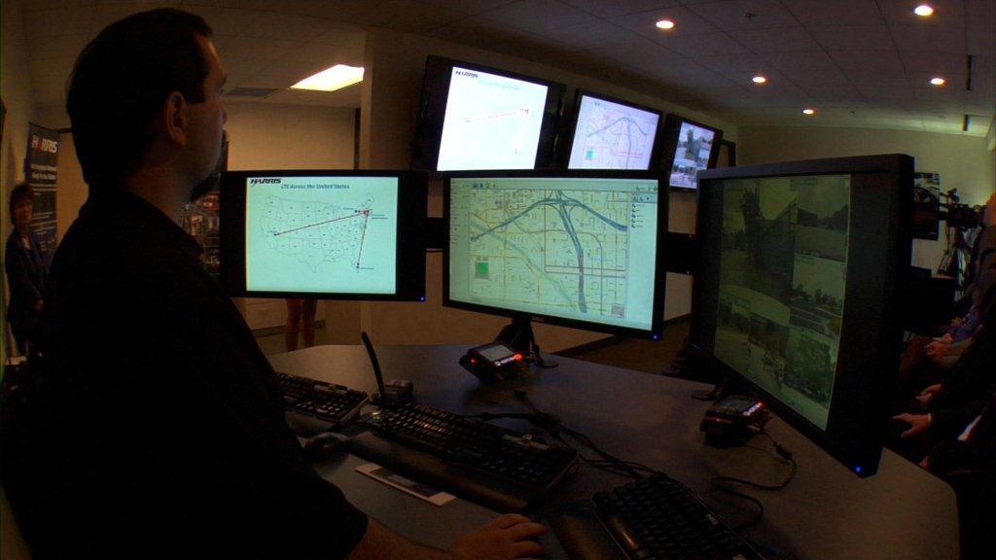
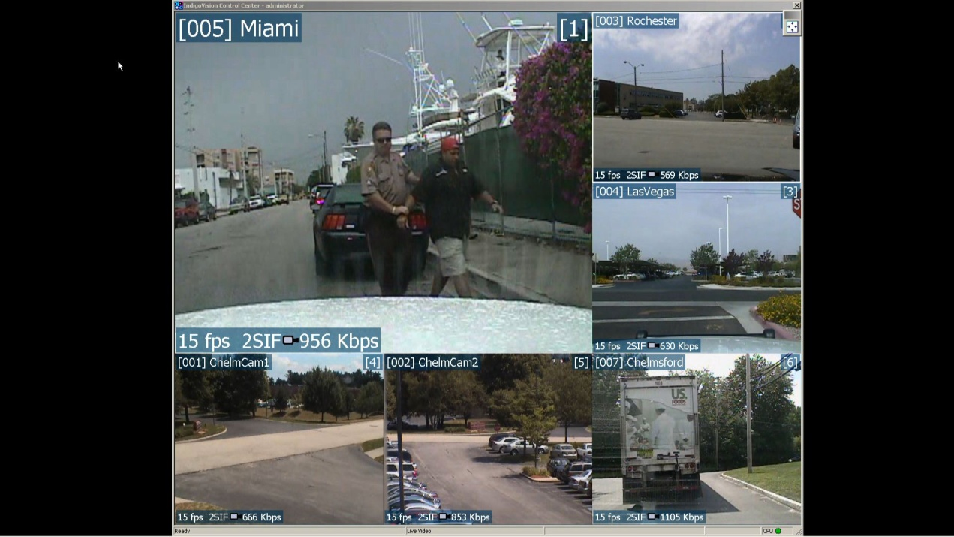
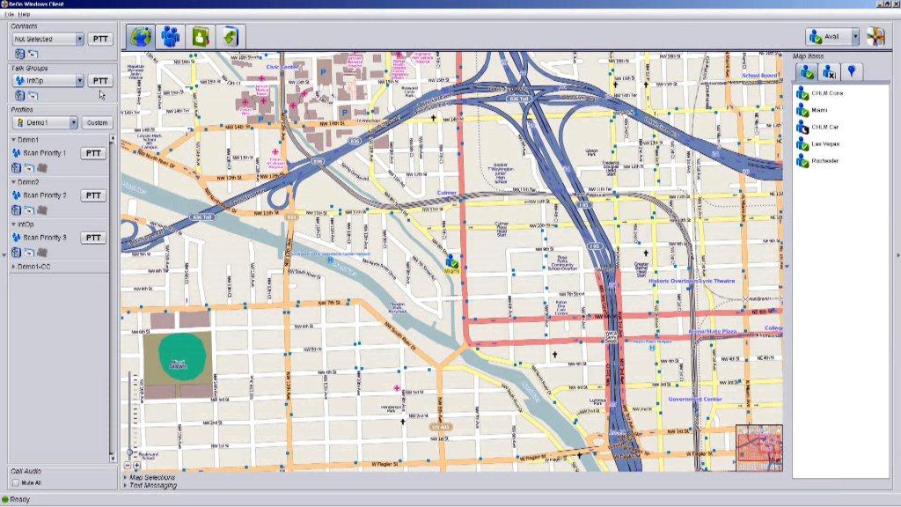
Nationwide LTE Demo Applications
Streaming video to dispatcher
Miami, Las Vegas, Rochester, Chelmsford
Real-time GPS mapping
Presence data

Slide 24
In Preparation for the New Dispatch Environment
Define call management, computer aided dispatch and broadband wireless solution and operational requirements
Collaborative effort between PSAP, network operators, information technology and end users
Participate in local, regional, state, national working committees to assess impact of NG-911 and LTE data on PSAP operations (join NPSTC BBWG Console LTE)
Meet with the vendor community to review their solutions and define your requirements
Work with your existing solutions providers to assess their product plans and provide input
Consult directly with PSAP personnel to obtain input
Provide required outreach and training to PSAP personnel
Determine budgetary requirements and secure funding (911 fees, grants, capital improvement funds)

Slide 25
Questions?
Rick Burke
Managing Partner
Televate, LLC
rburke@televate.com
(703) 639-4201

