Slide 1
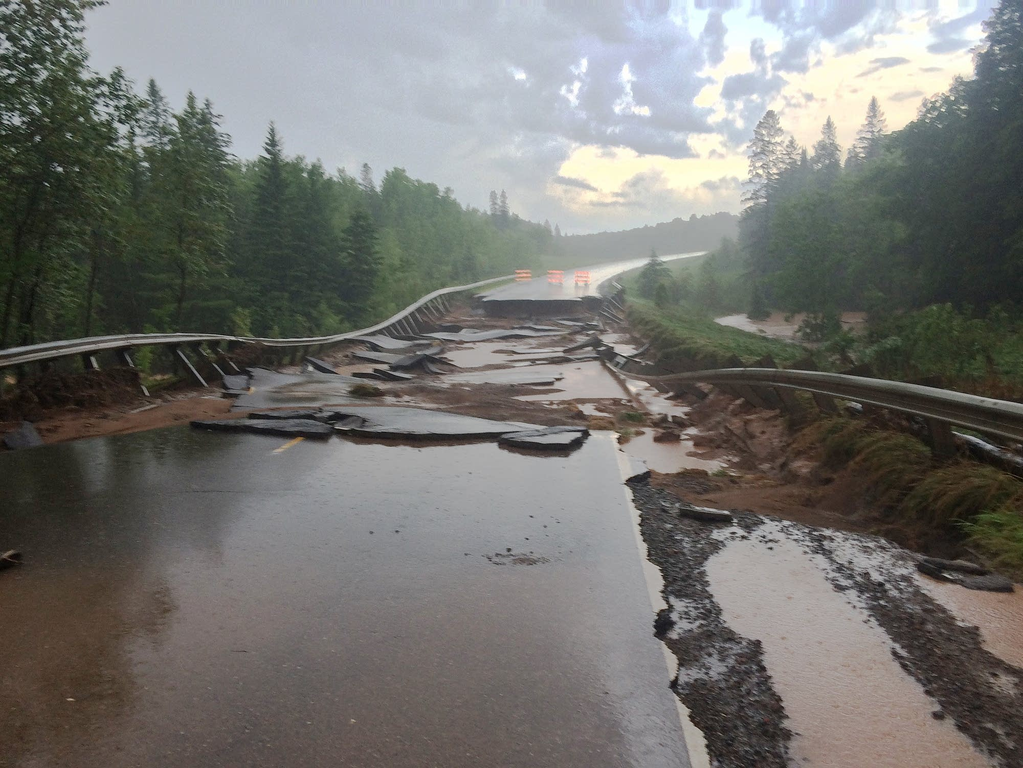

PowerPoint Topic
INFRASTRUCTURE RECOVERY
Minnesota Public Assistance Program
Sub topic
Presenter Names and Date

Slide 2
DR – 4390 Applicant Briefing
The Public Assistance Process
Disaster
Event
PDA
Governor’s
Request
Declaration
Exploratory
Call
Submission
of Request
Applicants’
Briefing
Recovery
Scoping Meeting
Project
Review
Approval
Subgrantee
Grantee
Funding

Slide 3
DR – 4390 Applicant Briefing
The Public Assistance Process
Disaster
Event
PDA
Governor’s
Request
Declaration
Declaration
Declaration
Submission
of Request
Applicants’
Briefing

Slide 4
DR – 4390 Applicant Briefing
The Public Assistance Process
Applicants’ Briefing
Conducted by the State
Applicant’s will fill out and submit
Request for Public Assistance (RPA)
Applicant’s will fill out and submit
Declaration of Assurance
Public Assistance Program Overview

Slide 5
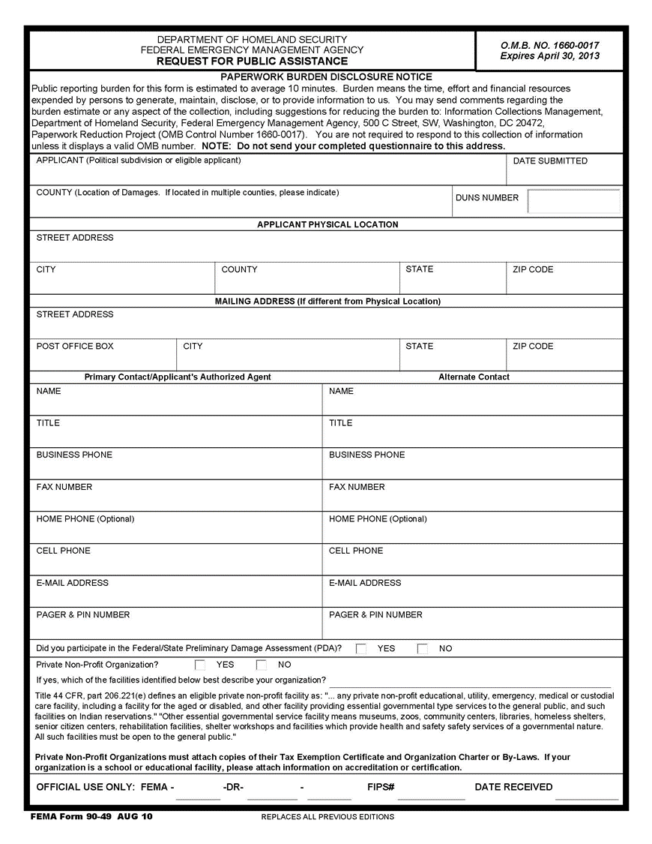
DR – 4390 Applicant Briefing
Request for Public Assistance (RPA)

Slide 6
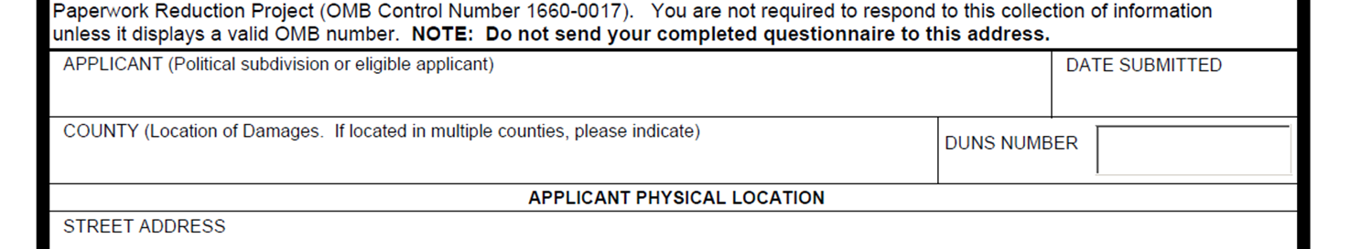
DR – 4390 Applicant Briefing
Request for Public Assistance (RPA)

Slide 7
DR – 4390 Applicant Briefing
Request for Public Assistance (RPA)

Slide 8
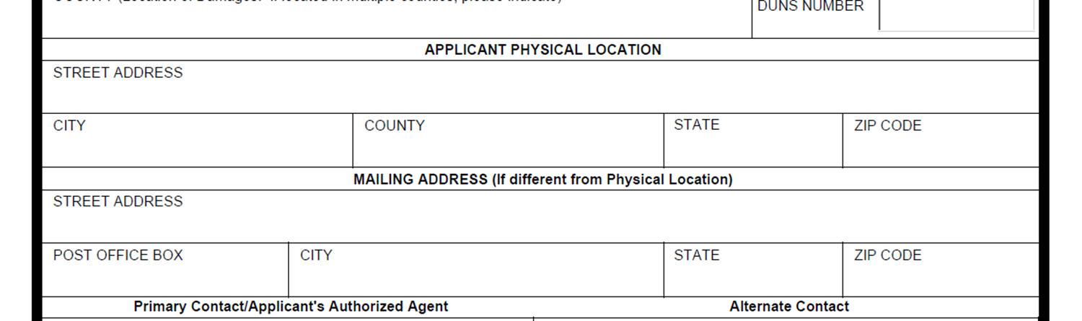
DR – 4390 Applicant Briefing
Request for Public Assistance (RPA)

Slide 9
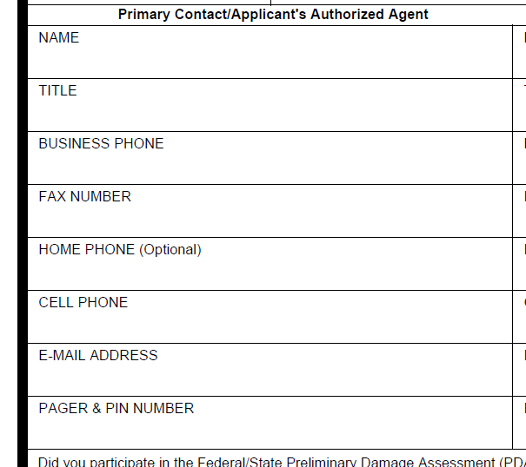
DR – 4390 Applicant Briefing
Request for Public Assistance (RPA)

Slide 10
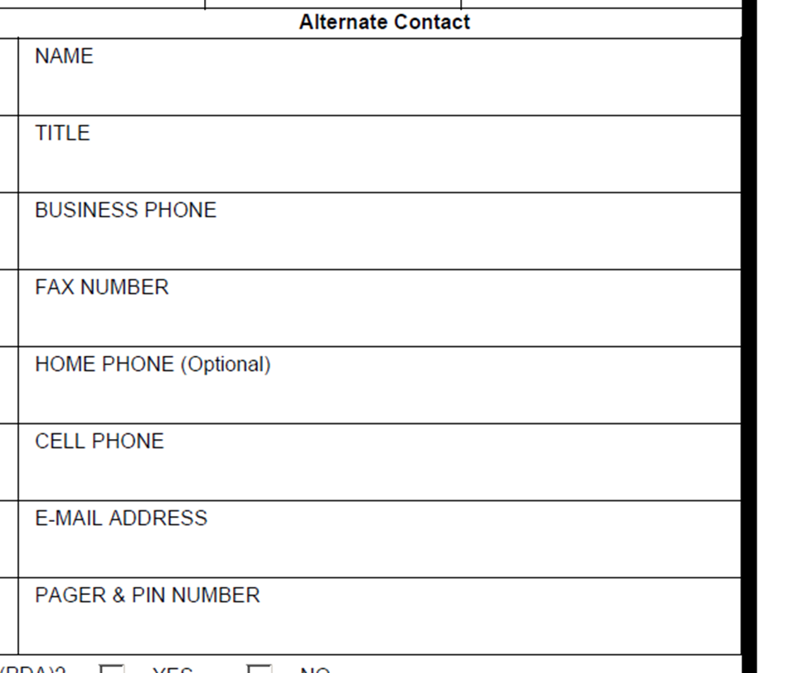
DR – 4390 Applicant Briefing
Request for Public Assistance (RPA)

Slide 11
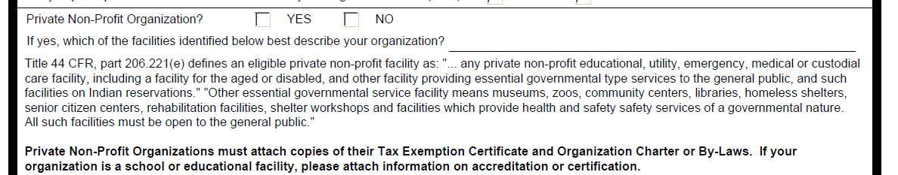
DR – 4390 Applicant Briefing
Request for Public Assistance (RPA)

Slide 12
DR – 4390 Applicant Briefing
The Public Assistance Process
New FEMA PA Program Delivery Model
Four phases of delivery:
  Phase I – Exploratory Call
  Phase II – Recovery Scoping Meeting
  Phase III – Project Formulation
  Phase IV – Review & Approval
  FEMA will continue to update and improve the new delivery model as it is implemented. Additional information is available on the new delivery model at https://www.fema.gov/new-public-assistance-delivery-model. Goal: Better grants management and fiscal responsibility from beginning to end.

Slide 13
DR – 4390 Applicant Briefing
The Public Assistance Process
Disaster
Event
PDA
Governor’s
Request
Declaration
Exploratory
Call
Submission
of Request
Applicants’
Briefing

Slide 14
DR – 4390 Applicant Briefing
The Public Assistance Process
Exploratory Call
Introduction - Program Delivery Manager (PDMG)
FEMA (PDMG) will Contact each applicant
PDMG will be a Single Point of Contact
Guide for entire Public Assistance Process
Get an initial sense of needs and damages
Identify Recovery Scoping Meeting participants

Slide 15
DR – 4390 Applicant Briefing
The Public Assistance Process
Disaster
Event
PDA
Governor’s
Request
Declaration
Exploratory
Call
Submission
of Request
Applicants’
Briefing
Recovery
Scoping Meeting
Project
Formulation
Review &
Approval

Slide 16
DR – 4390 Applicant Briefing
The Public Assistance Process
Recovery Scoping Meeting
In – Depth Meeting to Review Damages
Gather Applicant’s documentation
Develop List of Projects based on:
- Damage Description
- Eligible Scope of Work
- Cost Estimate of Damaged Sites

Slide 17
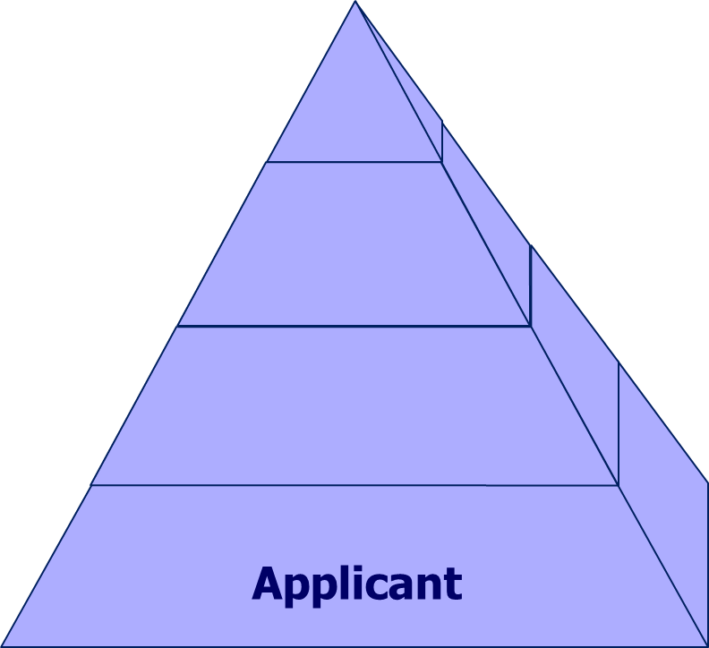
DR – 4390 Applicant Briefing
The Public Assistance Process
Eligibility Structure

Slide 18
DR – 4390 Applicant Briefing
The Public Assistance Process
Eligible Applicants
State Agencies
School Districts
County, City, & Township Governments
Tribal Governments and Organizations
Certain Private Non-Profit Organizations
Other political subdivisions of the State

Slide 19
DR – 4390 Applicant Briefing
The Public Assistance Process
Private Non-Profit Entities (Critical Services)
Private Non-Profit (PNP) facilities:
  Eligible for Public Assistance
    Fire / Emergency Rescue
    Medical Treatment
    Power, Water, & Sewer Utilities
    Communications Systems
    Educational Institutions

Slide 20
DR – 4390 Applicant Briefing
The Public Assistance Process
Private Non-Profit Entities
These facilities may provide essential services:
▪ Community Centers ▪ Homeless Shelters ▪ Museums
▪ Rehabilitation Facilities ▪ Senior Citizen/Day-Care Centers
▪ Shelter Workshops ▪ Zoos
▪ Other governmental health and safety services may be included.
All Non – Critical PNP’s must first apply to the Small Business Administration (SBA) for a disaster loan for permanent repair work before applying to FEMA.

Slide 21
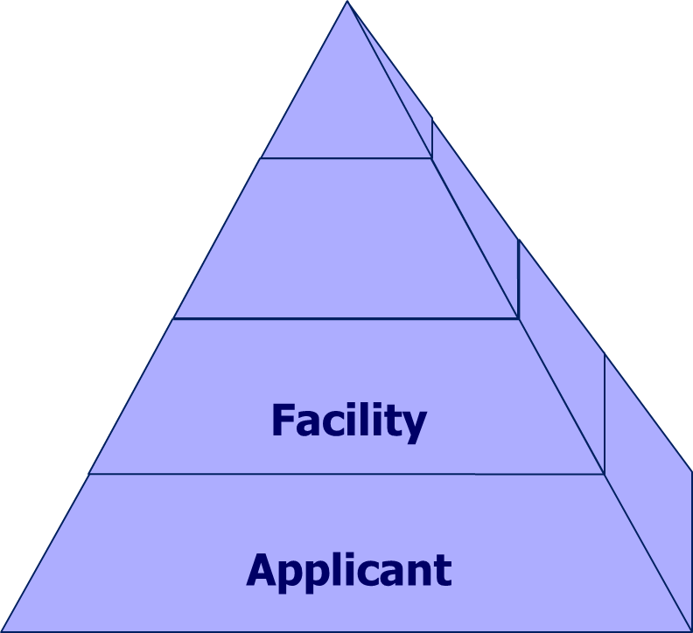
DR – 4390 Applicant Briefing
The Public Assistance Process
Eligibility Structure

Slide 22
DR – 4390 Applicant Briefing
The Public Assistance Process
Eligible Facility
To be eligible, the facility must be:
Legal responsibility of an eligible applicant
Damaged as a result of the declared disaster
Located within the designated disaster area
In active use at the time of the disaster
Not eligible for funding by another federal agency

Slide 23
DR – 4390 Applicant Briefing
The Public Assistance Process
Eligibility Structure
Work
Facility
Applicant

Slide 24
DR – 4390 Applicant Briefing
The Public Assistance Process
Eligible Work
To be eligible, the work must be Disaster related:
Emergency Work
  - Debris Removal & Protective Measures
Permanent Work
- Replace / Repair / Rebuild Damaged Infrastructure
  (Bridges, Buildings, Roads, Utilities & etc.)
Not Eligible for funding by another federal agency

Slide 25
DR – 4390 Applicant Briefing
The Public Assistance Process
Procurement Requirements
Applicants
Must comply with Federal, State & Local requirements (e-CFR 200.217 to 200.326)
Work completed by contractors must be advertised and competitively bid (see www.eCFR.gov)
Competitive proposals must be used to procure professional services (e.g. architect, engineer)
Project funding may be jeopardized by failing
to comply with these requirements

Slide 26
DR – 4390 Applicant Briefing
The Public Assistance Process
Eligibility Structure
Cost
Work
Facility
Applicant

Slide 27
DR – 4390 Applicant Briefing
The Public Assistance Process
Eligible Costs
To be eligible for reimbursement, costs must be:
  Reasonable and necessary to accomplish work
  Reduced by insurance or salvage values
  In compliance with local, state, and federal laws and regulations

Slide 28
DR – 4390 Applicant Briefing
The Public Assistance Process
Funding Formula
75% Federal Share
25% State Share / Local Match
State does match Utility Cooperatives,
but not other Private Non-Profits

Slide 29
DR – 4390 Applicant Briefing
The Public Assistance Process
Project Formulation
Minimum dollar amount $ 3,140 / PW
Small Projects – Under $ 125,500
Large Projects – Over $ 125,500
Type of Damage (Debris or Road Repairs)
Type of System (Electrical or Water)
Geographic Boundaries (Roadways)

Slide 30
DR – 4390 Applicant Briefing
The Public Assistance Process
Categories of Work
Emergency Work
A. Debris Removal
B. Emergency Protective Measures
Permanent Work
C. Roads and Bridge Systems
D. Water Control Facilities
E. Public Buildings / Equipment
F. Public Utilities
G. Other (Parks, Recreation, etc.)

Slide 31
DR – 4390 Applicant Briefing
The Public Assistance Process

Slide 32
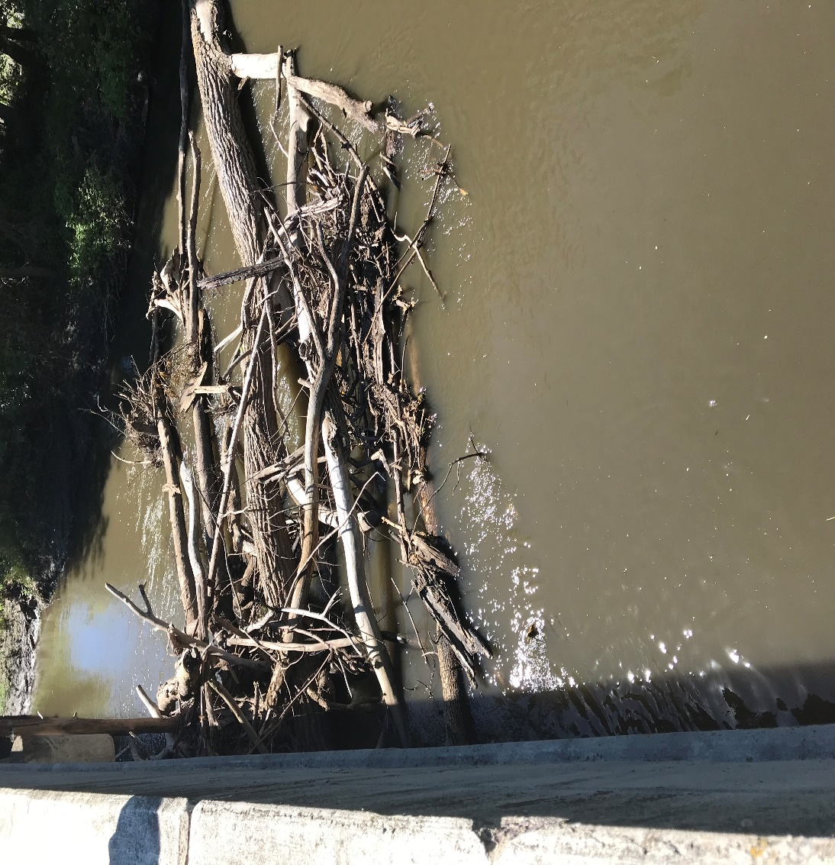
DR – 4390 Applicant Briefing
The Public Assistance Process
Emergency Work
Category A – Debris Removal
Debris removal is eligible when:
It eliminates an immediate threat to life, health, and safety
It eliminates an immediate threat of significant damage to improved property
It ensures economic recovery of the community and provides a benefit for the community-at-large

Slide 33
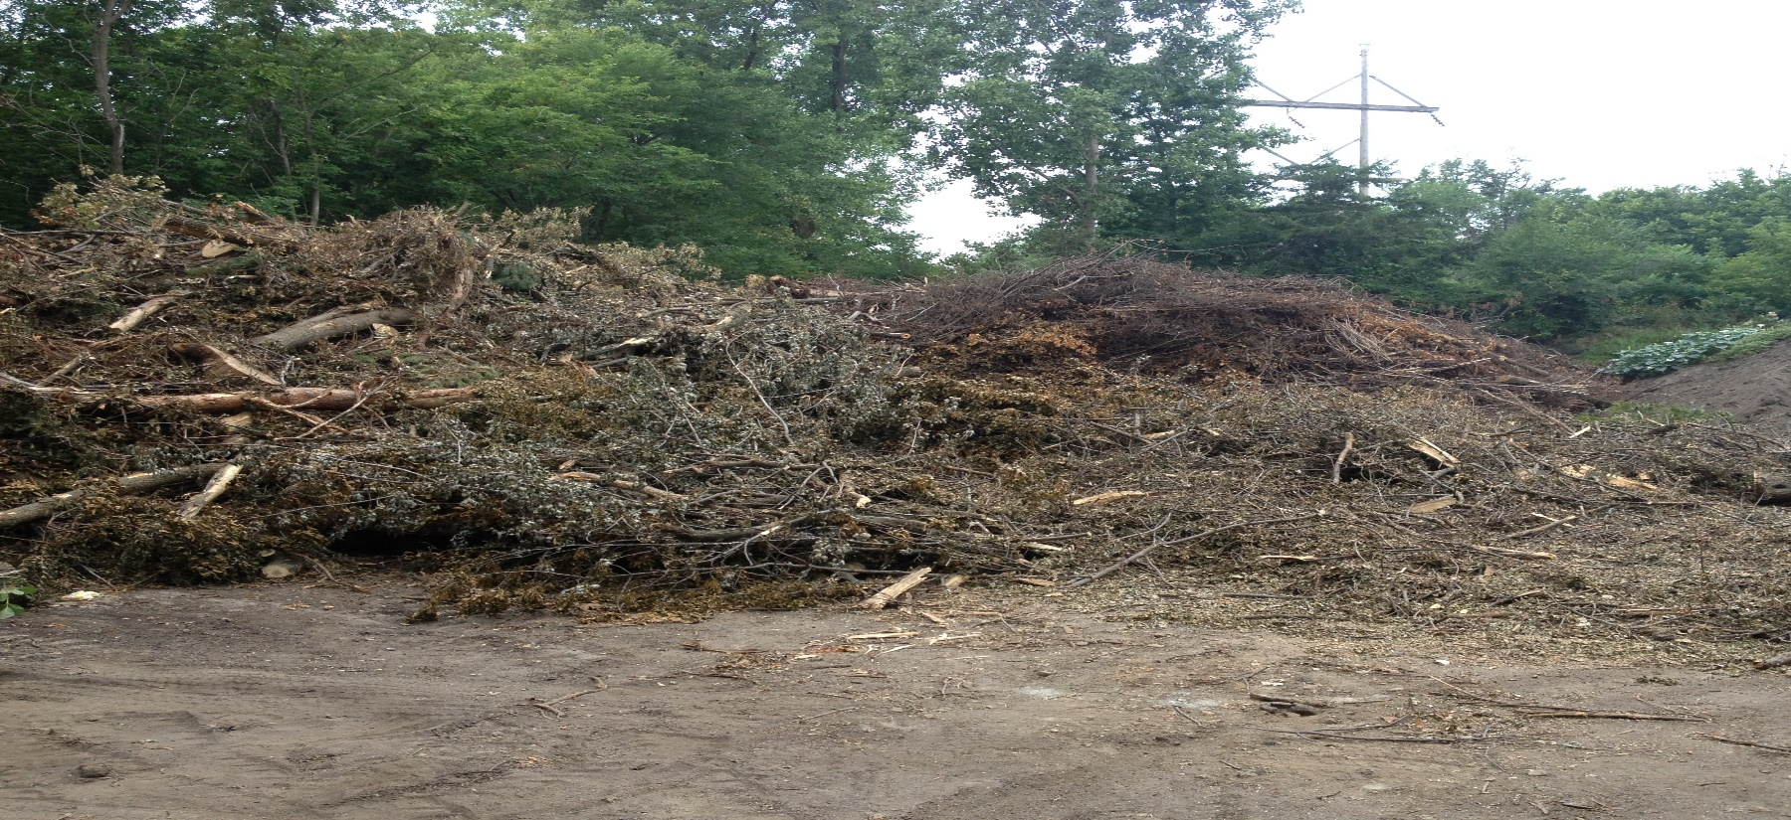
DR – 4390 Applicant Briefing
The Public Assistance Process
Emergency Work
Category A – Debris Removal

Slide 34
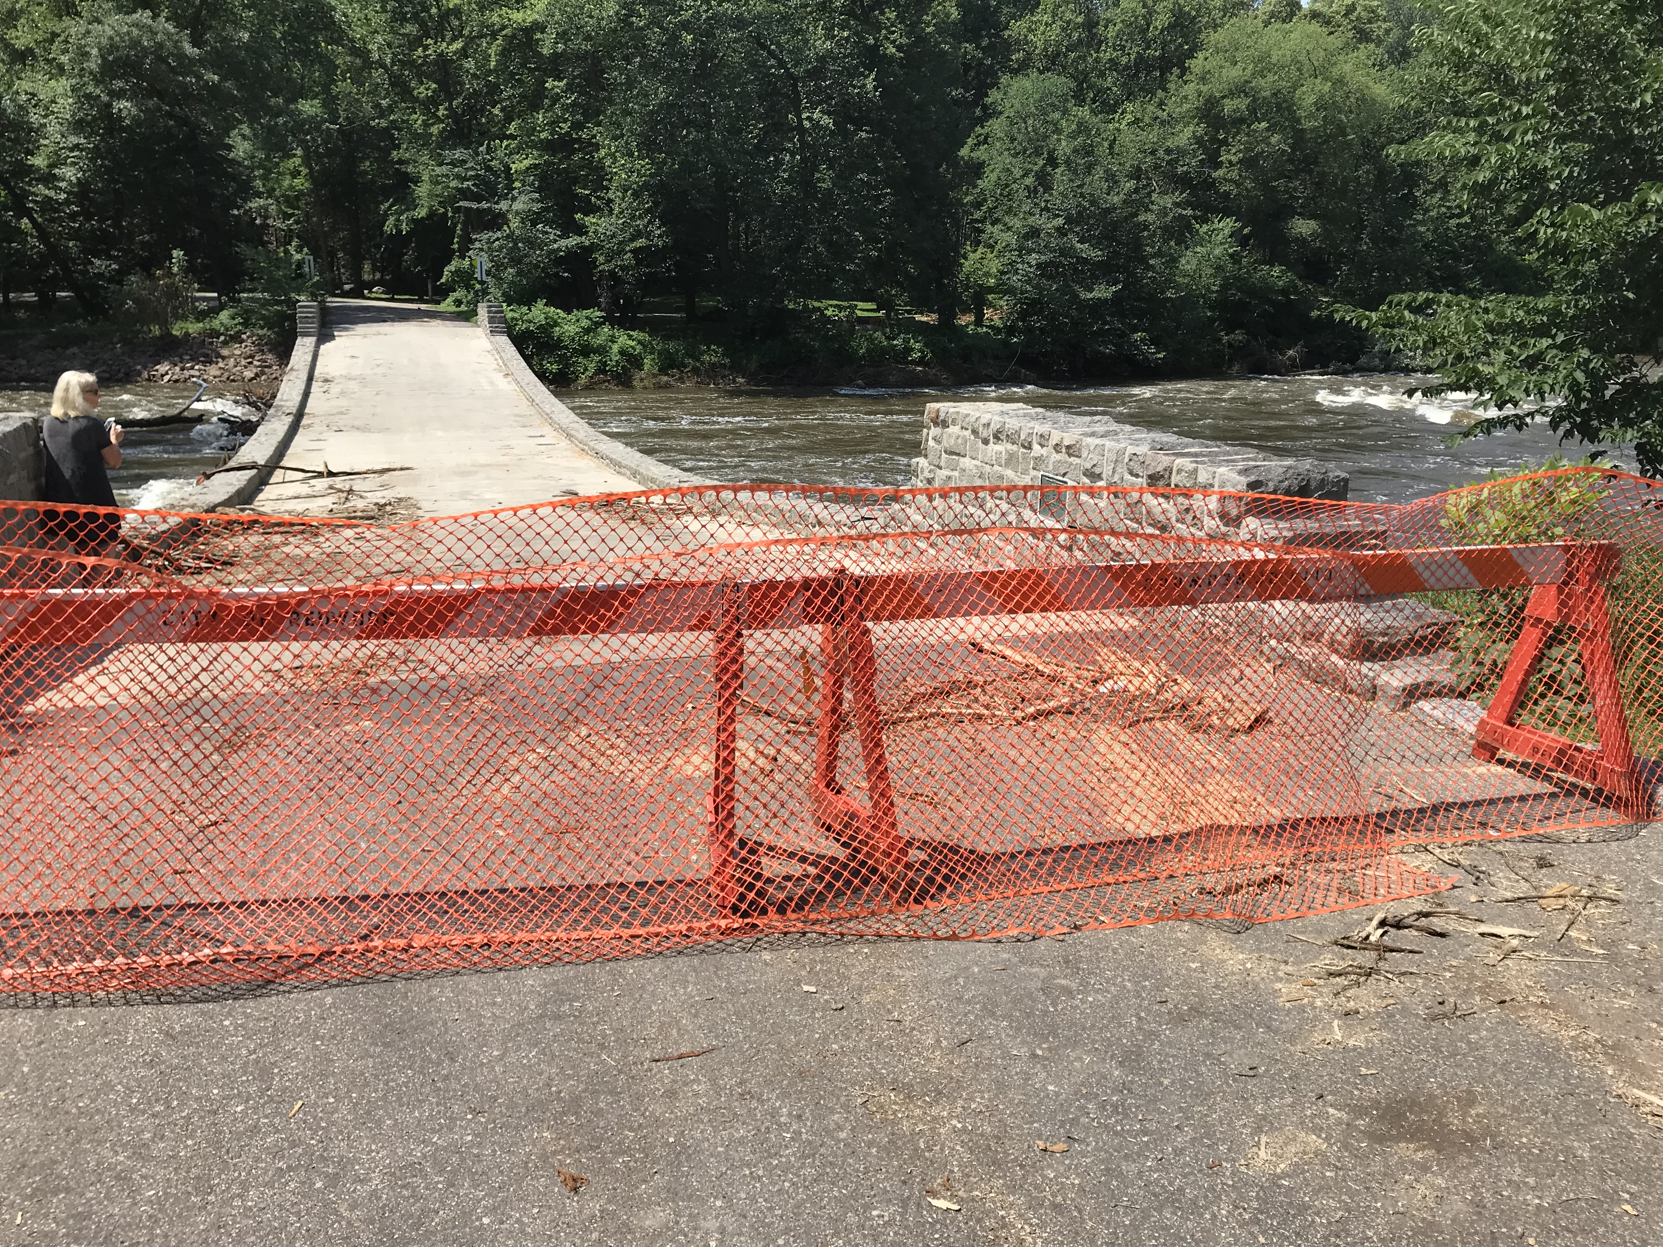
DR – 4390 Applicant Briefing
The Public Assistance Process
Emergency Work
Category B – Emergency Protective Measures
Emergency Protective Measures are actions taken by a community before, during, and following a disaster to save lives, protect public health and safety, or eliminate immediate threat of significant damage to improved public and private property through cost effective measures.

Slide 35
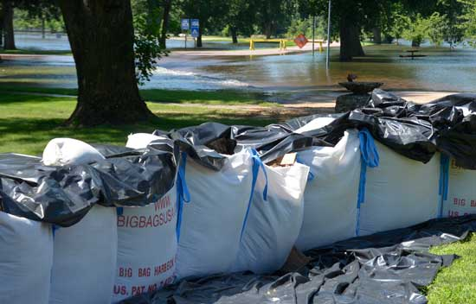
DR – 4390 Applicant Briefing
The Public Assistance Process
Emergency Work
Category B – Emergency Protective Measures

Slide 36
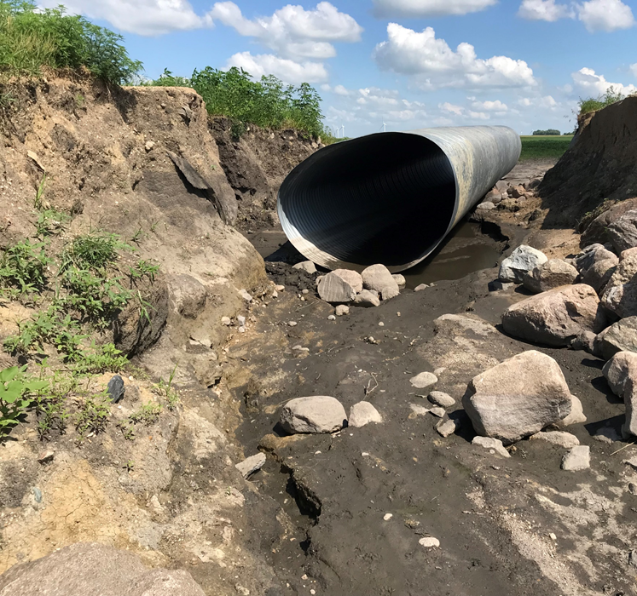
DR – 4390 Applicant Briefing
The Public Assistance Process
Permanent Work
Category C – Roads & Bridges
Repair of roads, bridges, and associated features, such as shoulders, ditches, culverts,
lighting, and signs.

Slide 37
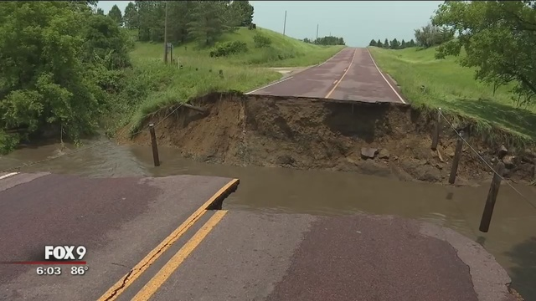
DR – 4390 Applicant Briefing
The Public Assistance Process
Permanent Work
Category C – Roads & Bridges

Slide 38
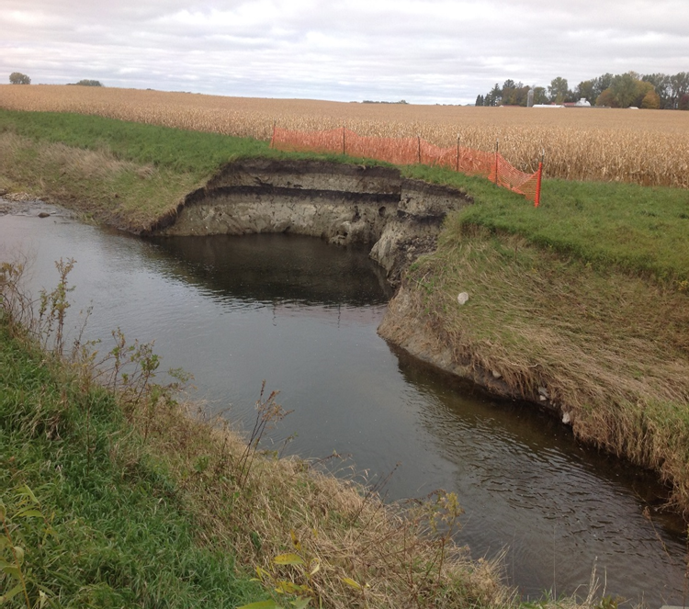
DR – 4390 Applicant Briefing
The Public Assistance Process
Permanent Work
Category D – Water Control Facilities
Repair of drainage channels, pumping facilities, and some irrigation facilities.
The eligibility of these facilities is restricted.

Slide 39
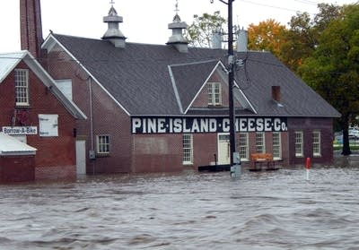
DR – 4390 Applicant Briefing
The Public Assistance Process
Permanent Work
Category E – Buildings & Equipment
Repair or replacement of buildings, including their contents and systems;
heavy equipment;
and vehicles.

Slide 40
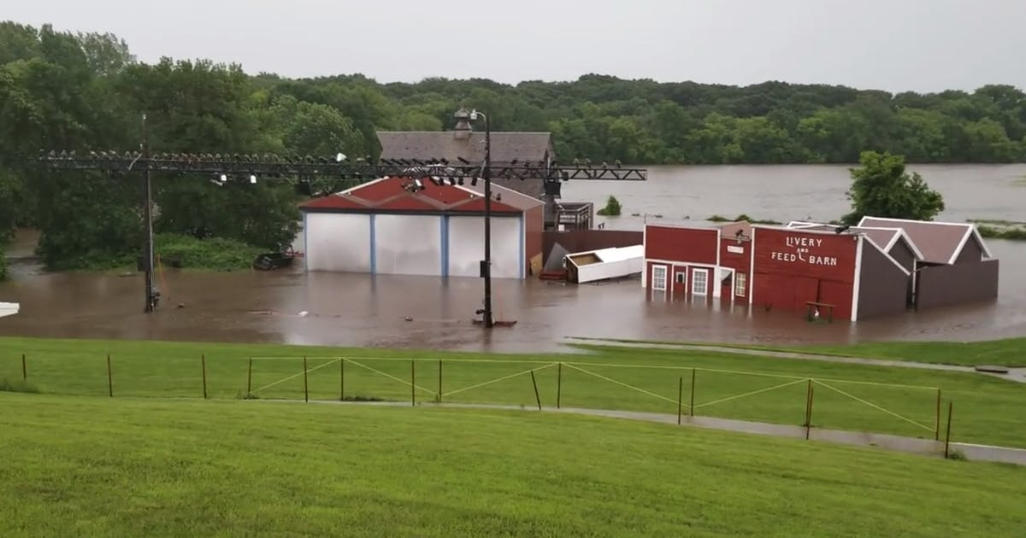
DR – 4390 Applicant Briefing
The Public Assistance Process
Permanent Work
Category E – Buildings & Equipment

Slide 41
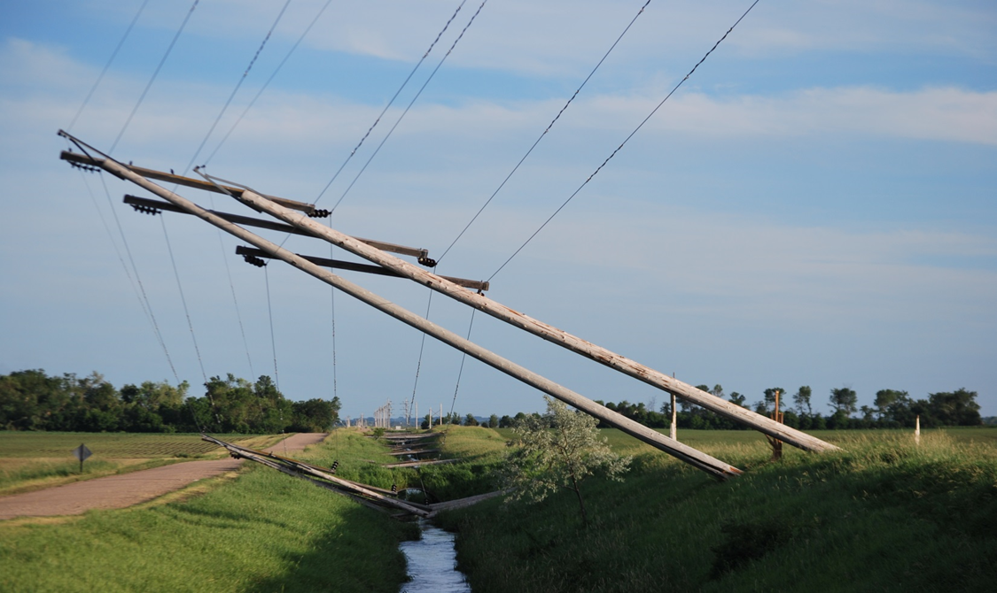
DR – 4390 Applicant Briefing
The Public Assistance Process
Permanent Work
Category F – Utilities
Repair of water treatment and delivery systems; power generation facilities and distribution facilities; sewage collection and treatment facilities;
and communications.

Slide 42
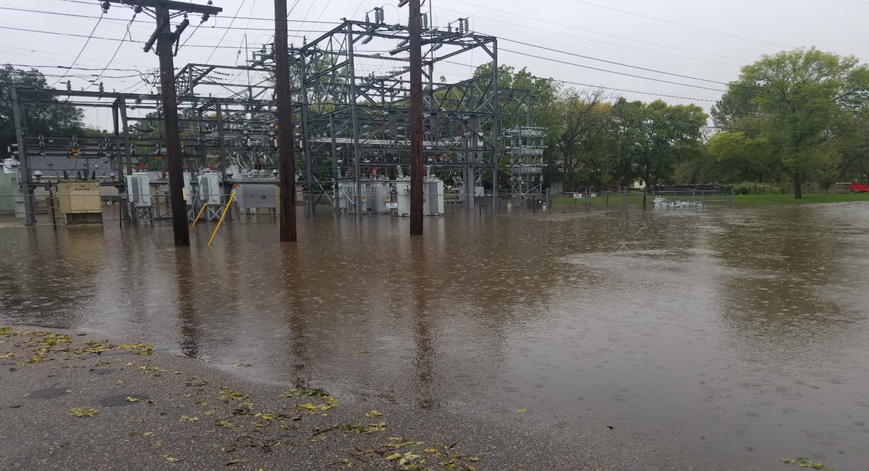
DR – 4390 Applicant Briefing
The Public Assistance Process
Permanent Work
Category F – Utilities

Slide 43
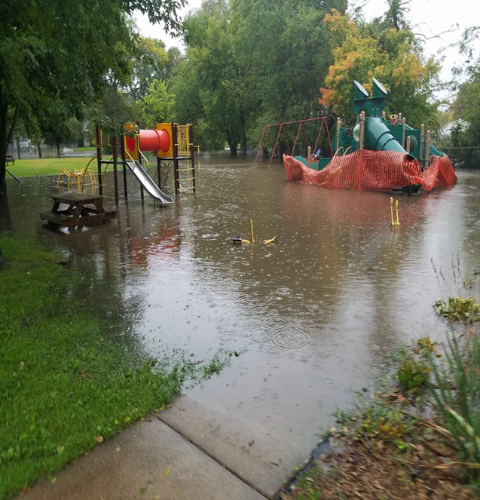
DR – 4390 Applicant Briefing
The Public Assistance Process
Permanent Work
Category G – Parks, Recreational Facilities and Other Items
Restoration of parks, playgrounds, pools, mass transit facilities, and beaches. This category also is used for any work or facility that cannot be characterized adequately by Categories A - F .

Slide 44
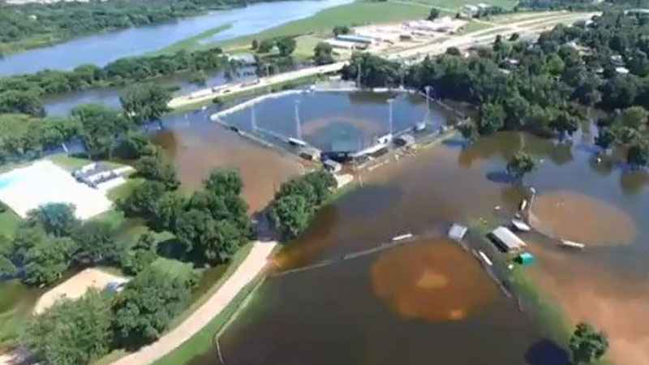
DR – 4390 Applicant Briefing
The Public Assistance Process
Permanent Work
Category G – Parks, Recreational Facilities and Other Items

Slide 45
DR – 4390 Applicant Briefing
The Public Assistance Process
Completion Deadlines - Projects
Time limits for project completion begin on the disaster declaration date.
Emergency work must be completed within 6 months
Permanent work must be completed within 18 months
For extenuating circumstances or project requirements beyond the subgrantee’s control, the Grantee may extend the emergency work deadline an additional 6 months and the permanent work deadline an additional 30 months on a project by project basis.

Slide 46
DR – 4390 Applicant Briefing
The Public Assistance Process
Eligible Time Frames – Projects
All Applicants need to be identified within 30 days of disaster declaration
All Project Worksheet documentation provided within 30 days of the Recovery Scoping Meeting
Additional damage site(s) identified within 60 days of the Recovery Scoping Meeting

Slide 47
DR – 4390 Applicant Briefing
The Public Assistance Process
Special Considerations
Special considerations are issues that could affect the scope of work and funding.
These issues include:
- Insurance
- Environmental Protection and Historical Preservation
- 406 Mitigation

Slide 48
DR – 4390 Applicant Briefing
The Public Assistance Process
Special Considerations - Insurance
Actual or anticipated insurance proceeds will be deducted from the eligible project costs for facilities that are insured.
All applicants are required to obtain and maintain insurance coverage on all insurable facilities, as a condition of Public Assistance funding.
For flood damaged facilities located within a Special Flood Hazard Area that are not covered by flood insurance, Federal assistance will be reduced by the maximum flood insurance proceeds that would have been payable had the facility been insured.

Slide 49
DR – 4390 Applicant Briefing
The Public Assistance Process
Special Considerations
– Environmental Protection
The National Environmental Policy Act (NEPA) provides a specific planning process that Federal agencies must follow before funding a project.
The process ensures that the agency decision makers and local governments have considered, and the general public is informed of, the environmental consequences of the Federal action.

Slide 50
DR – 4390 Applicant Briefing
The Public Assistance Process
Special Considerations
– Historic Preservation and Cultural Resources
National Historic Preservation Act (NHPA) Section 106 requires that Federal agencies take into account the effects a project will have on historic resources and allow the Advisory Council on Historic Preservation the opportunity to comment on the effects of the project. Restoration of historic landscapes and other facilities are limited by FEMA eligibility policies.
FEMA activities requiring NHPA compliance include projects affecting undisturbed areas that may contain archeological sites or have cultural, historic, or pre-historic significance.
FEMA is required to make a good faith effort to identify historic properties within a given project area’s potential effect.

Slide 51
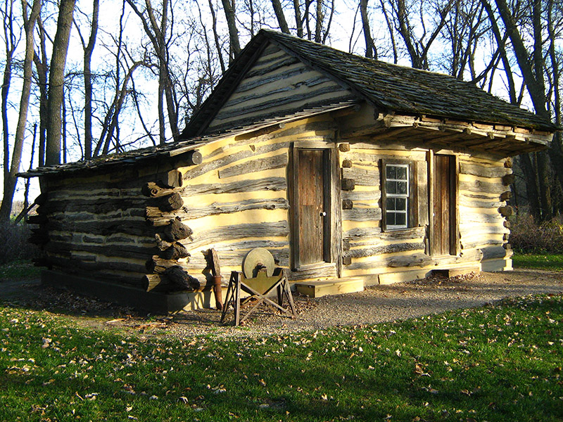
DR – 4390 Applicant Briefing
The Public Assistance Process
Special Considerations
- Historic Preservation and Cultural Resources
Property eligible for listing on the National Register of Historic Places requires special consideration under the National Historic Preservation Act. Facilities over 50 years old will require additional FEMA review.

Slide 52
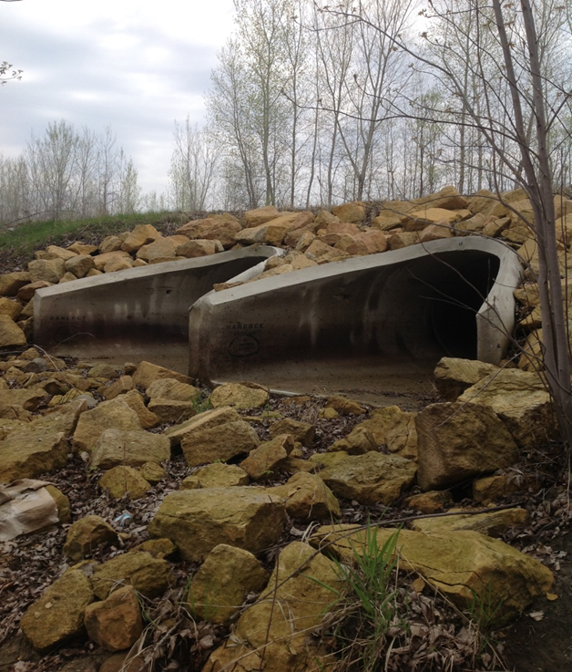
DR – 4390 Applicant Briefing
The Public Assistance Process
Special Considerations – 406 Hazard Mitigation
Cost effective measures that reduce or eliminate the potential for damages to a facility from a future event. For a hazard mitigation proposal to be eligible for funding under Public Assistance, the measure must apply only to the damaged elements of the eligible facility.

Slide 53
DR – 4390 Applicant Briefing
The Public Assistance Process
Review and Approval
After the PW documentation is gathered it will be sent to a Consolidated Resource Center (CRC) for Project Formulation.
PW’s must be reviewed and approved by the Applicant, then they can be entered into the FEMA software program.
The computer generated PW’s are created along with the supporting reports necessary to document the work.
This information is sent to HSEM for grant processing.

Slide 54
DR – 4390 Applicant Briefing
The Public Assistance Process
Disaster
Event
PDA
Governor’s
Request
Declaration
Exploratory
Call
Submission
of Request
Applicants’
Briefing
Recovery
Scoping Meeting
Project
Formulation
Review &
Approval
Subgrantee
Grantee
Funding

Slide 55
DR – 4390 Applicant Briefing
The Public Assistance Process
Grantee
The State is the grantee responsible for administering Public Assistance grants.
The grantee is accountable for the use of the funds provided by FEMA.
The grantee is also responsible for providing technical advice to eligible applicants.

Slide 56
DR – 4390 Applicant Briefing
The Public Assistance Process
Subgrantee
An eligible applicant is the subgrantee receiving a Public Assistance grant. The subgrantee is accountable to the grantee for the use of the funds provided by FEMA.
The subgrantee will provide documentation and personnel to work with FEMA assessing damages and creating Project Worksheets.
The subgrantee will provide the grantee with the documentation necessary to close out the grant after the eligible repairs are completed.

Slide 57
DR – 4390 Applicant Briefing
The Public Assistance Process
Funding
When the Project Worksheets are processed, FEMA is able to obligate the federal portion of the Public Assistance Grants to the Grantee (state).
The Grantee begins the process of making the funds available to the Subgrantee (applicant). The state’s share will be added to the process at this time.
FEMA will always provide 75% of the eligible cost estimate. There is a 25% local match required. The state legislature has determined that the state will provide the 25% local match.

Slide 58
DR – 4390 Applicant Briefing
The Public Assistance Process
Where can I learn more about the
Public Assistance Grant Program?
Public Assistance Program and Policy Guide (PAPPG)
FP 104 - 009 - 2 / April 2018 www.fema.gov
2 CFR Code of Federal Regulations, 200.317 – 200.326 Emergency Management and Assistance
The Robert T. Stafford Disaster Relief and
Emergency Assistance Act

Slide 59
DR – 4390 Applicant Briefing
The Public Assistance Process
Hazard Mitigation Grant Program (404)
Typical project types to mitigate against future damages
and injuries include:
  Acquisition of hazard prone structures
  Power-line retrofit /burial (co-ops and municipal)
  Community Tornado Safe Rooms (new or retrofit, for schools, trailer parks, open areas)
  Minor localized flood reduction
Hazard Mitigation is long-term recovery

Slide 60
DR – 4390 Applicant Briefing
The Public Assistance Process
Other Agency Assistance
Federal Highway Administration,
Federal-Aid Highway Emergency Relief Program
Natural Resources Conservation Service (NRCS),
Emergency Watershed Protection Program (EWP)
Small Business Administration (SBA), Disaster Loan

Slide 61
DR – 4390 Applicant Briefing
The Public Assistance Process
HSEM Disaster Recovery Team - Contacts
  Bill Hirte
  Public Assistance
  Program Administrator
  bill.hirte@state.mn.us
  651-201-7431
Jennifer Nelson
State Hazard Mitigation Officer
Jennifer.e.nelson@state.mn.us
651-201-7427
  John Moore
  Recovery & Mitigation
  Branch Director
  john.moore@state.mn.us
  651-201-7453
Angela Brown
Disaster Recovery
Coordinator
angela.d.brown@state.mn.us
651-201-7496

Slide 62
DR – 4390 Applicant Briefing
The Public Assistance Process
QUESTIONS ?

