Slide 1



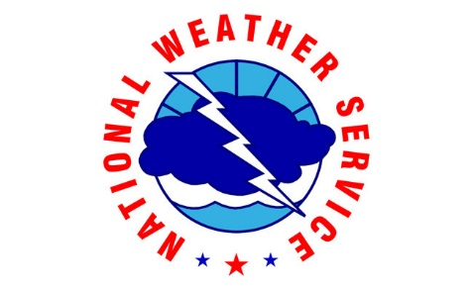

Minnesota
Severe Weather Awareness Week
April 8 - 12, 2024

Slide 2
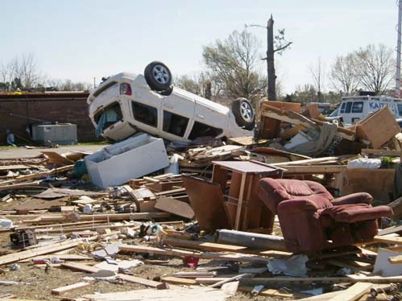
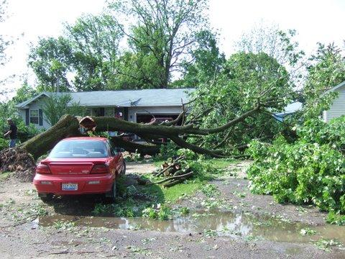
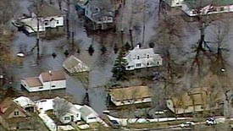
What is Severe Weather Awareness Week?
Statewide information campaign to inform and refresh knowledge about severe weather threats.
Aim is to enable citizens to be better prepared and take appropriate action when necessary.

Slide 3
April 8 – 12, 2024
Each day of the week focuses on a different topic:
  Monday – Weather Alerts and Warnings
  Tuesday – Severe Storms, Lightning and Hail
  Wednesday – Floods and Flash Floods
  Thursday – Statewide Tornado Drill Day
  Friday – Extreme Heat and Wildfires
Information and topics will continue throughout spring and summer on the HSEM website under “Weather Safety”

Slide 4
Severe Weather Hazards Are Real
The top severe weather hazards in Minnesota are:
    Severe storms, hail and lightning
    Floods
    Tornadoes
    Extreme heat

Slide 5
Weather Alerts and Warnings
Topic for Monday, April 8
Severe weather warnings are issued by the National Weather Service.
  Know the terms and what they mean.
Warning sirens are operated by each county.
Personal weather alerts – Many cell phone apps and local media outlets and internet sites offer free local personal weather alerting services.
Wireless Emergency Alerts – Sent by authorities to all cell phones in specific area to warn of a dangerous situation or critical information.

Slide 6
Types of Warnings
Topic for Monday, April 8
WEATHER WARNING -
  A dangerous weather or event is occurring or imminent.
  Likely significant threat to life or property.
  Take protective action immediately.
WEATHER WATCH -
  Weather conditions are favorable for a hazardous weather event.
  Stay alert to changing conditions.
  Make alternate plans.
  Be aware of possible shelter or evacuation routes.
WEATHER ADVISORY -
  Less hazardous weather conditions or less specific locations.
  Weather may still pose significant safety risk or travel problems.
  Situations are possible that could threaten life or property.

Slide 7
Personal Weather Alerts
Topic for Monday, April 8
Personal and localized electronic weather alerts are available across Minnesota from weather related apps or local media outlets in a variety of formats.
  Email
  Text messages
  Cell phones
  Computers
  Tablets
  Social media
  Sample of sources:
  (Check local media.)
  Weather.com
  Accuweather.com
  Emergency Email & Wireless Network
  WCCO
  KARE11
  KSTP
  KMSP
  KAAL –TV
  KBJR6/Range 11
  WDAY – Fargo/Moorhead
  KELO – SW Minnesota

Slide 8
Siren Activation Information
Topic for Monday, April 8
Counties and cities in Minnesota own and operate all warning sirens in their jurisdictions.
Check with your local public safety officials to learn when and why warning sirens are sounded in your community.
Sirens normally sound for about two to three minutes and then go silent.
There is no such thing as an "all-clear" siren.

Slide 9
Severe Thunderstorms, Lightning and Hail
Topic for Tuesday, April 9
Thunderstorms affect relatively small areas.
A typical thunderstorm is 15 miles in diameter and lasts for about 30 minutes.
Severe thunderstorms can produce large hail or have winds of at least 58 mph.
Some wind gusts can exceed 100 mph and produce tornado-like damage.

Slide 10
Facts About Thunderstorms
Topic for Tuesday, April 9
Warm, humid conditions are favorable for storm development.
Storms may occur singly, in clusters or in lines.
Storms typically produce heavy rain for a brief period.
Ten percent of storms are severe – typically including high winds and large hail.

Slide 11
Facts About Hail
Topic for Tuesday, April 9
Hail is larger than sleet and forms in thunderstorms.
Updrafts are strong rising currents of air within a storm that carry water droplets to a height where they freeze and become hail.
Hail can range from pea-sized (most common) to as large as baseball-sized or more.
Large hail stones fall faster than 100 mph and can injure or even kill people.

Slide 12
Facts About Lightning
Topic for Tuesday, April 9
All thunderstorms produce lightning.
A bolt of lightning can be over five miles in length.
Lightning can strike up to 15 miles away from the center of a storm.
Your chance of being struck by lightning once in your lifetime: 1 in 12,000. (NWS Data)
“Heat” lightning doesn’t exist - it is flashes from a far-away storm that can’t be heard.

Slide 13
Know the Warning Terms
Topic for Tuesday, April 9
Severe Thunderstorm Watch
Weather conditions are favorable for producing severe thunderstorms. Remain alert and stay informed.
Severe Thunderstorm Warning
Severe weather has been reported or indicated on weather radar. Seek shelter immediately.

Slide 14
Before Severe Storms and Lightning
Topic for Tuesday, April 9
Secure outdoor objects.
Close/shutter windows and secure outside doors.
Consider postponing outdoor activities.
Know where the nearest shelters are.
Know where to get weather reports.
Have a weather radio with battery backup.
Check your emergency kit – is it ready?

Slide 15
During Thunderstorms with Lightning
Topic for Tuesday, April 9
The safest place to be during a thunderstorm is any normal building (with water pipes or electricity).
Most hard top cars are safe from lightning.
(It is the metal roof and metal sides that protect you, NOT the rubber tires.)
  Convertibles, motorcycles, bicycles, fiberglass vehicles offer no protection from lightning.
  Avoid contact with interior metal during the storm.

Slide 16
During Thunderstorms with Lightning
Topic for Tuesday, April 9
No place outside is safe when thunderstorms are in the area.
If you hear thunder, lightning is close enough to strike you.
When you hear thunder, immediately move to safe shelter: a building or an enclosed, metal-topped vehicle with windows up.
Stay in safe shelter at least 30 minutes after you hear the last sound of thunder.

Slide 17
During Thunderstorms with Lightning
Topic for Tuesday, April 9
If you are outside and cannot find shelter:
Avoid tall trees, hilltops, open fields, beaches, cliffs.
Avoid ungrounded sheds or flimsy structures – especially in open areas.
If you are in a boat – get to shore and off the water as soon as possible and find shelter.
Get to the lowest area available that is not in flood area.

Slide 18
Facts about Lightning
Topic for Tuesday, April 9
All thunderstorms produce lightning. If you can hear thunder, you are in range of lightning.
Lightning often strikes the same place repeatedly, especially if it’s a tall, pointed, isolated object.
Lightning can strike up to 15 miles from the center of the thunderstorm, far from the rain or storm cloud.

Slide 19
Floods and Flash Floods
Topic for Wednesday, April 10
One of the most common natural hazards in Minnesota.
Seasonal snowmelt floods tend to develop slowly.
Flash floods develop quickly during heavy rains leaving little time for preparation.
Risks are greater in low-lying areas, near existing water, behind a levee or downstream from a dam.

Slide 20
Know the Flood Warning Terms
Topic for Wednesday, April 10
Flood or flash flood watch
Conditions exist for possible flooding.
Flood warning
Flooding is occurring or will occur soon.
Flash flood warning
A flash flood is occurring or will occur soon.
  Seek safety or higher ground immediately and avoid flooded roadways.

Slide 21
Before a Flood
Topic for Wednesday, April 10
Buy flood insurance for your home at least 30 days ahead of flood season.
Elevate basement furnaces, water heaters, and electric panels.
Install check valves in sewer traps.
Construct barriers or dikes if possible.
Seal basement walls.
Prepare for evacuation if necessary.
  Have a plan and inform family and neighbors.
  Have a “go kit” ready with valuables and important papers and enough supplies to last several days.

Slide 22
During a Flood - Plan
Topic for Wednesday, April 10
Listen to radio or TV for information.
Be aware of streams, drainage channels and canyons.
Be aware of road and bridge closures; find alternate routes.
Move immediately to high ground if flood waters are near.
Be prepared to evacuate on short notice.

Slide 23
During a Flood - Prepare
Topic for Wednesday, April 10
If you must evacuate, and time permits:
  Secure your home.
  Bring in outdoor furniture.
  Move essential items to an upper floor.
  Turn off utilities.
Plan an evacuation route and inform family and neighbors of destination.

Slide 24
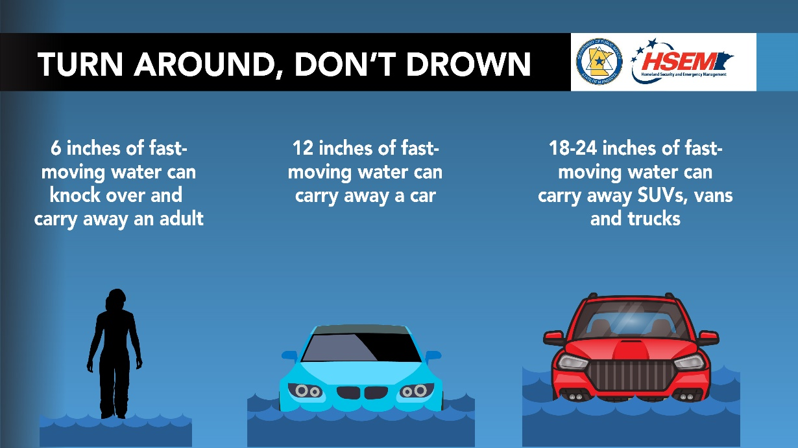
During a Flood – Don’t Drive
Topic for Wednesday, April 10
Do not walk or drive through moving water.
Do not drive on flooded roads.
Be aware of downed power lines.

Slide 25
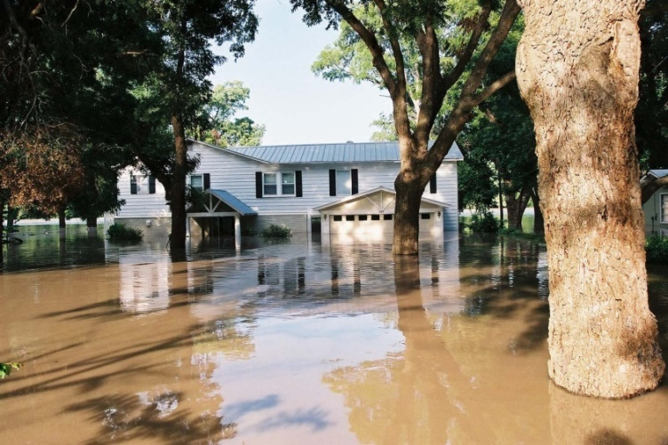
After a Flood
Topic for Wednesday, April 10
Return home only when authorities indicate it is safe.
Use caution when
entering buildings.
Service damaged
septic tanks,
cesspools, pits, and
leaching systems.
Clean and disinfect damaged property.
Have alternate sewage/toilet capacity.

Slide 26
Tornado Drill Day – April 11
Topic for Thursday, April 11
Tornado Safety Information
Nature’s most intensely violent storm.
Minnesota averages 40 tornadoes per year – but in 2021 the state had 64 tornadoes. This includes 22 tornadoes on Dec. 15 alone!
Tornadoes may strike quickly with little warning.
Tornadoes can occur any time of day or night but often occur in the late afternoon or evening.

Slide 27
Know the Tornado Warning Terms
Topic for Thursday, April 11
Tornado watch
Weather conditions are favorable for tornadoes; remain alert for approaching storms.
Tornado warning
A tornado has been sighted or indicated by weather radar; take shelter immediately.

Slide 28
Before a Tornado
Topic for Thursday, April 11
During a Tornado Watch
Be alert to changing weather conditions.
Know your surroundings and location.
Have a plan for severe weather.
Have a programmed NOAA Weather Radio operating.
Listen to radio or TV or check the internet frequently for up-to-date information.

Slide 29
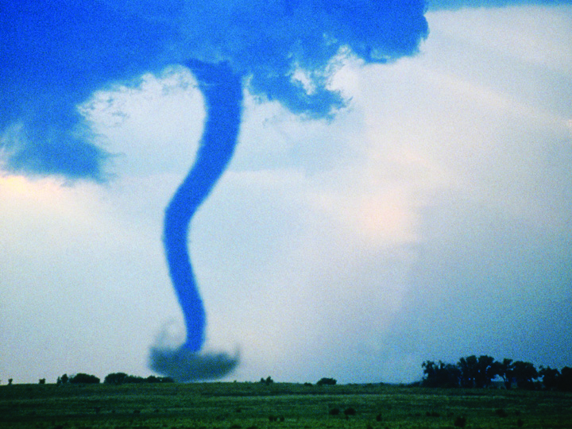
During a Tornado Warning
Topic for Thursday, April 11
Find shelter immediately.
Seek a small interior room.
Get away from glass windows.
Leave mobile homes or
trailers.
If outside, lie flat in a ditch or
depression and cover your
head.
Do not get under an overpass
or bridge.
If in a vehicle – stop and find
shelter in a strong building
nearby immediately.
Watch for flying debris.

Slide 30
Tornado Drill Day
Topic for Thursday, April 11
Afternoon Tornado Drill: Thursday, April 11 - 1:45 p.m.
  NWS will send simulated warnings to NOAA Weather Radios.
  All counties across Minnesota sound outdoor warning sirens.
  Schools, businesses, and organizations are encouraged to conduct a tornado drill at this time to practice their own tornado sheltering plans.
Evening Tornado Drill: Thursday, April 11 - 6:45 p.m.
  Severe weather and tornadoes occur most often between 3 - 8 p.m.
  Second drill allows second-shift workers and families at home to practice their sheltering plans.
  County participation is voluntary.

Slide 31
Tornado Drill Day – How to Participate
Topic for Thursday, April 11
Prepare Your Home
Create or update emergency plans with your entire family.
Practice your family plan during the evening tornado drill at 6:45 p.m.
Check emergency plans at places your family spends time, such as schools, workplaces, churches, markets, or sports facilities.
Share the plans for these areas with your entire family.
Involve your neighbors. Find out who has special needs and might need help in an emergency.
Plan with your neighborhood. Ask your Home Owners Association, your Tenants Group or Neighborhood Civic Association to make emergency preparedness an agenda item during your next meeting.
Help neighbors get informed. Host a neighborhood preparedness meeting. Invite your local emergency manager or responders to help lead the discussions.
Prepare Your Neighborhood

Slide 32
Tornado Drill Day – How to Participate
Topic for Thursday, April 11
Prepare Your Community
Include preparedness activities at community events.
Host a Local Preparedness Fair.
Create or participate in a Citizen Corps - Community Emergency Response Team (CERT).
Designate critical function or emergency personnel.
Organize an emergency preparedness procedures review.
Host a disaster preparedness brown bag lunch for employees.
Get a NOAA Weather Radio.
Distribute a facility emergency plan.
Conduct business continuity training.
Schedule an emergency exercise or drill.
Prepare Your Workplace

Slide 33
Extreme Heat
Topic for Friday, April 12
Heat-related fatalities outpace deaths in several other weather categories.
Based on a national average excessive heat claims 219 lives each year.
By contrast, floods kill 88, tornadoes 57, lightning 52 and hurricanes 15.

Slide 34
Heat Problems
Topic for Friday, April 12
Heat cramps are muscular pains and spasms that usually occur in the legs or abdomen caused by exposure to high heat and humidity, and loss of fluids and electrolytes.
  Find a cool location to rest and take fluids (water or sports drinks).
Heat exhaustion typically involves the loss of body fluids through heavy sweating during strenuous exercise or physical labor in high heat and humidity.
  Signs of heat exhaustion include cool, moist, pale or flushed skin; heavy sweating; headache; nausea; dizziness; weakness; and exhaustion.
Heat stroke (also known as sunstroke) is a life-threatening condition in which a person’s temperature control system stops working and the body is unable to cool itself.
  Signs of heat stroke include hot, red skin which may be dry or moist; changes in consciousness; vomiting; and high body temperature.
  Heat stroke is life-threatening. Call 911 immediately!

Slide 35
During a Heat Wave
Topic for Friday, April 12
Drink more fluids – avoid alcohol and high-sugared drinks.
Stay in an air-conditioned place during the hottest parts of the day.
If air conditioning is not available, be in a location with adequate shade, air-flow and ventilation.
Make use of public venues or cooling centers if necessary.
Wear lightweight, light-colored, loose-fitting clothing.
NEVER leave any person or animal in a closed, parked vehicle.

Slide 36
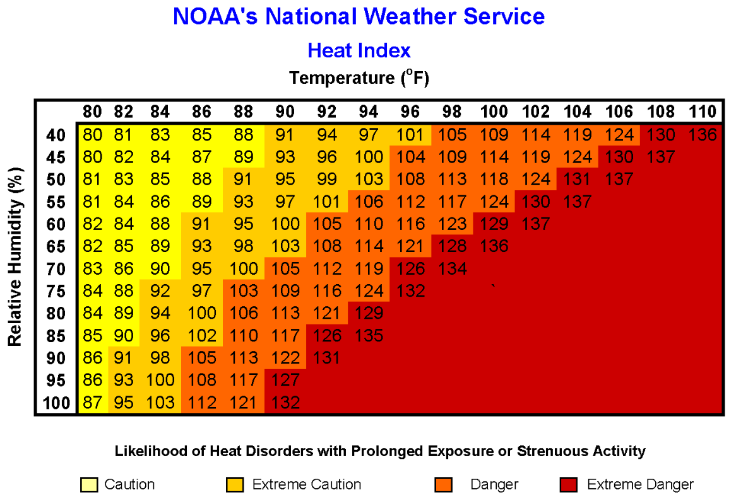
Heat Index
Topic for Friday, April 12
The Heat Index is a measure of how hot it feels when relative humidity is added to the air temperature.
Heat Index values are based on shady conditions with a light wind; exposure to full sunshine can increase values by up to 15 degrees.

Slide 37
Know the Heat Warning Terms
Topic for Friday, April 12
Excessive Heat Warning
Issued within 12 hours of the heat index reaching one of two levels. A warning will be issued if :
  The heat index is greater than 105°F for any period.
Excessive Heat Watch
Issued when the heat index is expected to be greater than 105ºF and nighttime low temperature will be at least 75ºF or higher for two consecutive days.

Slide 38
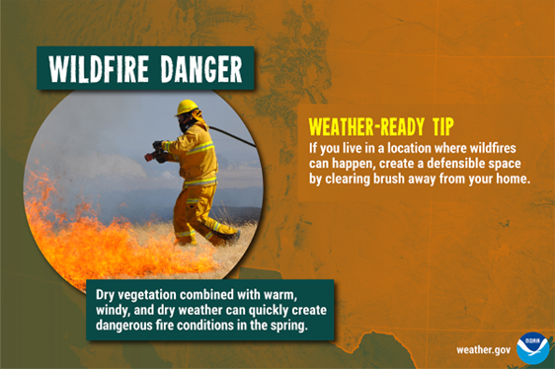
Firewise in Minnesota
Topic for Friday, April 12
Firewise is a program designed to addresses the risk of homes in the wildland/urban interface to wildland fire. As more homes are built in the woods and fields of Minnesota, the existing firefighting resources are less able to protect everyone's property while trying to control a wildfire.
Homes close to evergreens and the tall grasses of prairies or marshes are most at risk. Making your home able to survive an approaching
wildfire is the goal of the
Firewise program.
The Minnesota Department
of Natural Resources (DNR)
has adopted the national
Firewise program for fire
prevention information and
preparedness.

Slide 39
Health Threat From Wildfire Smoke
Topic for Friday, April 12
Smoke from wildfires is a mixture of gases and fine particles from burning trees and other plant materials. Smoke can hurt your eyes, irritate your respiratory system, and worsen chronic heart and lung diseases.
Review the pages on the CDC website about how smoke from wildfires can affect your health.

Slide 40
Sources For More Information on Severe Weather and Safety
Severe Weather Awareness Week
Severe Storms, Lightning and Hail
Floods and Flash Floods
Tornadoes
Alerts and Warnings
Extreme Heat and Wildfires

Slide 41
How to prepare for any emergency
Four simple preparedness steps:
Have a Family Emergency Plan
Make a Emergency Supply Kit
Stay Informed
Get Involved

