Slide 1

MMIW Task Force: Intersections with the child welfare response to trafficking and exploitation
Sarah Ladd, JD
Minnesota Department of Human Services
July 8, 2020

Slide 2

Welcome!
Sarah Ladd, JD
Child welfare response to trafficking and exploitation
Potential intersections with missing and murdered indigenous women (MMIW)
Notes:
Each introduce (2 minutes)

Slide 3
“How does child welfare impact American Indian youth?”
Oppression, abuse and trafficking lead to laws protecting American Indian families
Present
Sexual abuse; normalization of exploitation; missing youth
ICWA and MIFPA; out of home placement rates; prevalence
History
Intersections

Slide 4
Expanding Recognition of Trafficking and Exploitation
Youth
History and current poly-victimization
Gender
Race, ethnicity, political status
Poverty
Trafficking and Exploitation Can Happen to Anyone
Anyone can be recruited, lured, tricked, or enticed into becoming a trafficking victim, most often through a job offer or a trusted relationship.
Some individuals may be more vulnerable.

Slide 5
It is all connected
Non-commercial sexual abuse
Trafficking, exploitation and risk
Runaway youth

Slide 6
How do trafficking and exploitation impact American Indian youth in the child welfare system in Minnesota?
More than 1,683 total reports of sex trafficking or sexual exploitation made to county or tribal child welfare agencies from May 29, 2017- June 30, 2020
More than 1,500 total alleged child victims of sex trafficking or sexual exploitation.
How does this impact American Indian youth and families?
American Indian youth were 5.8 times more likely to be reported as victims of sex trafficking or sexual exploitation than Caucasian youth.
10% of alleged victims in reports of sex trafficking or sexual exploitation were ICWA eligible (44% screened in).
In the child welfare system in Minnesota, across all types of abuse and neglect, American Indian children are 18.1 times more likely to go into out of home placement than Caucasian children. (2018 MN child maltreatment report)
For more information: general child welfare data provided by DHS
Notes:
Talking points:
All data based on the Social Service Information System (SSIS) gathered from all child welfare agencies statewide and analyzed by the DHS Child Safety and Permanency Division.
ICWA stands for Indian Child Welfare Act
There are two tribal child welfare agencies that are child welfare initiative tribes in Minnesota: White Eartha and Leech Lake. Red Lake will become an initiative tribes in January 2021 and Mille Lacs later in 2021.
Data on out of home placement disproportionality is from the 2017 Minnesota Child Maltreatment Report.
DHS staff has met with 13 tribes, tribal organizations and American Indian community organizations in creating a best practices guide and legislative proposal to improve the child welfare response to trafficking and exploitation, with a focus on American Indian youth. The largest theme was regarding what American Indian youth need after being identified as a victim: child welfare staff and service providers should focus on keeping American Indian youth in their community and supporting a sense of identity, cultural values and belonging as they are in the process of healing from trafficking or exploitation.

Slide 7
Child Welfare Response to Trafficking and Exploitation in Minnesota

Slide 8
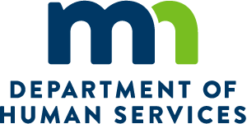

Safe Harbor Statewide Services
Missing and Endangered Persons
Internet Crimes Against Children
3 Regional Law Enforcement Task Forces
1 Statewide Task Force: 24/7 reporting 651-793-7000
Training/Consultation for Law Enforcement on Sex Trafficking Investigations
Tribal Liaison
Protocol Guidelines
Safe Harbor Protocol Team Formation Starter Kit: A Guide for New Teams
Protocol Implementation
Regional Navigators and Specialized Community Services
OVC Expansion Grant to include Labor Trafficking
Training & Technical Assistance
Youth and Hotel Outreach Materials
Wilder Evaluation Report
Safe Harbor for All
Tribal Liaison
Specialized Housing/Shelter
Youth Outreach
Child Protection/Child Welfare
Vulnerable Adult Protection
Tribal liaison

Slide 9
Minnesota’s child welfare system: Overview of response
Screen in or out
Yes
Family Assessment Response
Family Investigation
No
Child welfare response
Report of maltreatment to child protection intake

Slide 10
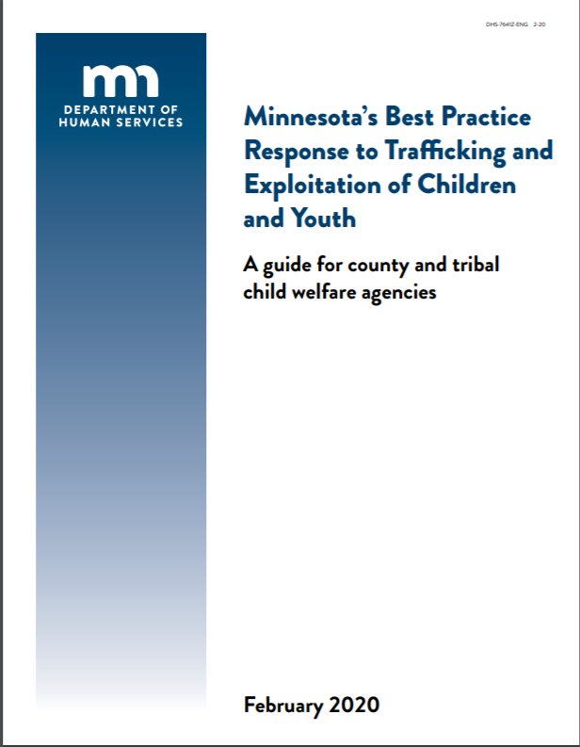
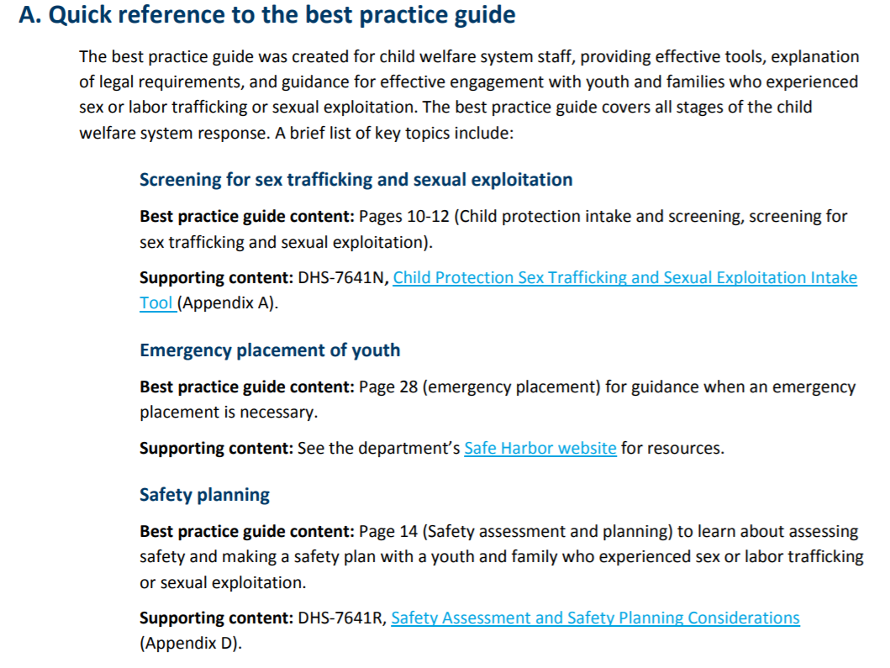
Child welfare response to human trafficking and exploitation
Notes:
Me- 15 minutes through slide 13

Slide 11
Minnesota’s
Child Protection Response to Human Trafficking and Exploitation
Child Sex Trafficking
Sex Abuse
Child Abuse and Neglect
Investigation (24 hour response)
The Basics
Sex trafficking of a child is a mandated report in Minnesota, even if the alleged trafficker is a non-caregiver/ household member. When in doubt, report.
Sex trafficking requires three parts:
  ACTOR: Third party trafficker (not the buyer or victim)
  ACTION: Receiving, recruiting harboring, providing, or obtaining; or profiting
  ACT: Aid in the prostitution of an individual
Reports of sexual exploitation (without a third party) or labor trafficking should be referred to voluntary child welfare services through the county or tribal agency.
Law enforcement and county or tribal child welfare agencies must promptly cross report. All youth and families must be screened for ICWA/ MIFPA eligibility as soon as possible.
Notes:
DARIANN
Effective May 29, 2017, Minnesota’s child welfare system is required to respond to all reports of sex trafficking involving children.
That response is driven by changes to the federal and state child protection laws.
Changes to Minnesota Statute were made in the 2015-16 legislative session so that all reports of child sex trafficking must be investigated by child protection as a form of sexual abuse. (Minn. Stat. 626.556 subd 2(n) and 3e) Here in Minnesota, three very important parts that support the changed response to sex trafficking are: (1) training for child protection workers, (2) increased coordination with safe harbor and other systems, and (3) accurate data collection.
See www.mn.gov/dhs/safe-harbor for more information about the new child welfare system response to trafficking and exploitation.
*Contact Sarah Ladd, DHS Child Protection Program Coordinator for more information or assistance with this new response*
Sarah K. Ladd, JD Esq.
Human Trafficking Child Protection Program Coordinator |
Child Safety and Prevention Unit
Minnesota Department of Human Services
444 Lafayette Road North
St. Paul, MN 55155
Voice (651) 431-4702
Cell phone (920) 530-8388 (for urgent matters)
Sarah.ladd@state.mn.us

Slide 12
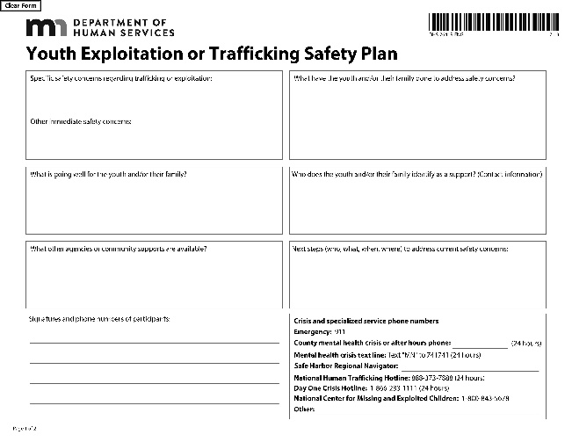
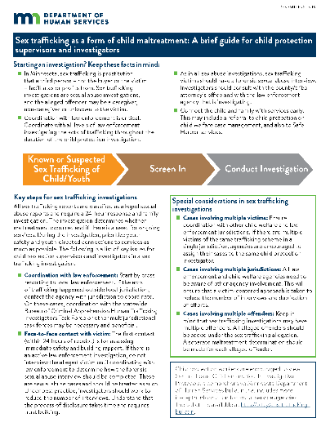
What else does child welfare do? Safety planning and investigations
Safety planning with the youth and family: based on the individual needs and risks
Investigating the report of sex trafficking or sexual exploitation: includes a maltreatment determination

Slide 13
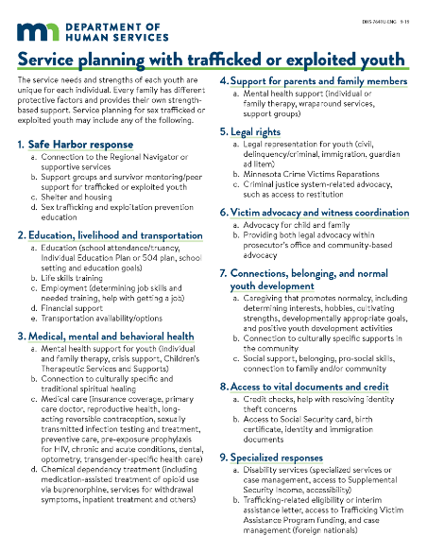
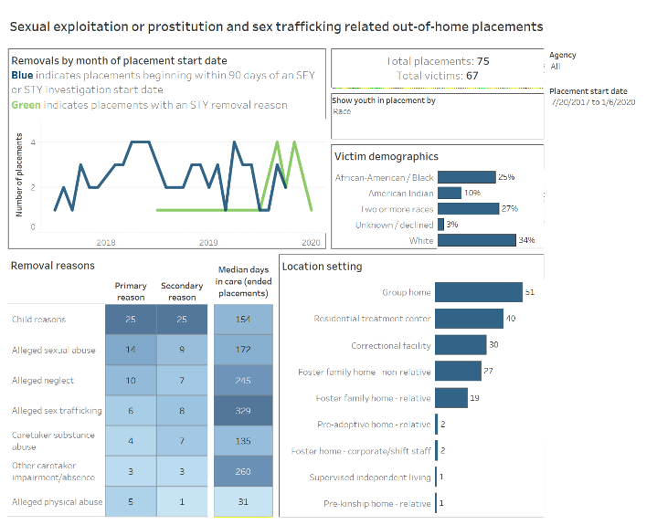
What else does child welfare do? Case management and placement
Case management: strengths based approach to connecting youth and family with services that meet their needs
Out of home placement: if it is unsafe for the youth to remain at home a placement should be made based on the youth’s best interests; if youth runs from placement, caseworker must search for the youth, report, and find out what happened after youth is located

Slide 14
Considerations for child welfare’s work with American Indian youth who have experienced trafficking or exploitation
Caseworkers should focus on building trust and learning about background of family
Connect youth and family to the culturally specific services and traditional practices they want, even when they are not enrolled tribal members
Youth should be kept in home community for services and placement whenever safe to do so
Support the youth in rebuilding their sense of identity, belonging and role in community
Follow all applicable laws and policies when youth is eligible for ICWA or MIFPA
Response should be whole-family focused and trauma-informed, recognizing youth as a whole person
Notes:
NOTE on other feedback about responses: we have heard from ICWA Advisory Council chairs and other tribal child welfare folks that they do not feel the current shelter/array of residential services is helpful for their youth, this is something DHS Is aware of and working to improve

Slide 15
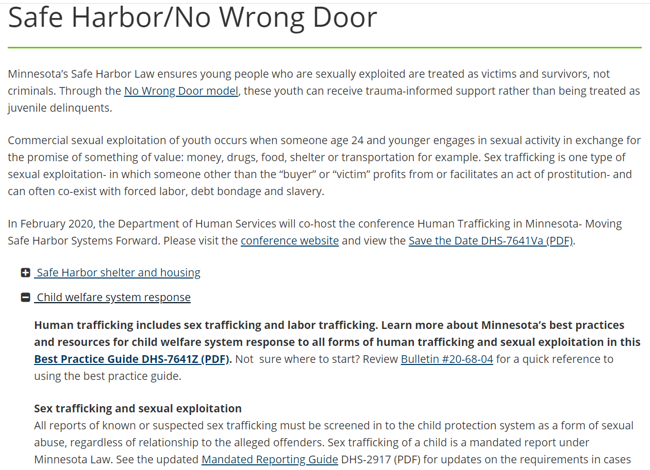
DHS Child Welfare: Trafficking and Exploitation Website
www.mn.gov/dhs/safe-harbor for all documents and policies, tools and resources created by the work group.

Slide 16
Recommendations and ongoing efforts
Proposal: create a new Non-caregiver sex trafficking assessment response track in child protection (Bills proposed in FY 2020 session)
Proposal: require training for all child welfare staff statewide on how to identify and respond to reports of sexual exploitation and sex trafficking, including specific content on working with American Indian youth
Funding needed: increase resources for specialized child welfare and community based services for American Indian youth and families experiencing any form of trafficking or exploitation
Staffing needed: American Indian Human Trafficking Child Welfare Liaison (.5 FTE funded under federal OVC grant, beginning October 2020)- need for full time role in partnership with DHS Indian Child Welfare Unit. Two focus areas:
  Develop specialized responses with resources dedicated to improving the response to trafficking and exploitation of American Indian youth
  Improve coordination with law enforcement, particularly in emergency placement, response to youth who are missing, and joint investigations.

Slide 17

Questions and discussions
How do you see the intersection between MMIW and child welfare response to trafficking and exploitation?
What else do you want to understand about the child welfare response?
As we develop more specialized responses, is there anyone specifically we should talk to?

Slide 18
Thank you!
mn.gov/dhs/safe-harbor
Sarah Ladd, JD Esq. Office (651) 319-1017 Sarah.ladd@state.mn.us
Human Trafficking Child Protection Program Coordinator
Minnesota Department of Human Services, Child Safety and Prevention Unit

