Slide 1


Expanding the Health Care Response to
Human Trafficking and Exploitation in Minnesota
Leah Lutz| Leah Lutz Consulting
Caroline Palmer, JD| Safe Harbor Director, MDH

Slide 2
1. Safe Harbor Overview
2. Health Care Provider Training
3. Next Steps

Slide 3

Working Together
Safe Harbor is a network
  Services
  Presentations
  Referrals
  Collaboration

Slide 4
Safe Harbor History
2005
Anti-Trafficking Laws Passed
2011-2014
No Wrong Door Model Created
2014
Safe Harbor Law Takes Effect and Services Implemented
2006
Human Trafficking Task Force Established
2008
Sex Trafficking Needs Assessment Identifies Gaps
2009
Sex Trafficking Laws Amended to Increase Penalties
Shattered Hearts Report
2011
Safe Harbor Law Enacted
Garden of Truth Report
2017
Federal Grant to Expand Services for Youth Victims of Labor Trafficking and tribes
New Child Protection Response
Protocol Guidelines
2018-2019
Safe Harbor for All Community Engagement Process and Strategic Plan Submitted to Legislature
Protocol Team Pilot Sites
MSS question
2016
Safe Harbor Service Eligibility Raised to Age 24
2019 Wage Theft Law
New federal grant continuing tribal support and new labor trafficking protocol partnership with BCA
MSS analysis

Slide 5
No Wrong Door Values
Training to identify sexual exploitation
Services are offered statewide
Youth have a right to privacy and self-determination
Youth who are sexually exploited are victims of crime
Victims should not feel afraid, isolated or trapped
Trauma-informed care
Services that are responsive to the needs of individual youth
Positive youth development principles
Sexual exploitation can be prevented

Slide 6
Minnesota Safe Harbor Law
Sexually exploited youth
17 years old and under
can no longer be criminalized for engaging in prostitution but should be referred to services.
Sexually exploited and at risk youth 24 years old and under deserve and are eligible for specialized, trauma-informed services to heal and recover.

Slide 7




Commercial Sexual Exploitation
Eligibility for Safe Harbor Services for Youth Ages 24 and younger
Anything of value (e.g., money, drugs, food, shelter, rent, or higher status in a gang or group)
- OR -
a promise of anything of value
is given to a person by any means in exchange for any type of sexual activity.
A third party may or may not be involved.

Slide 8


Safe Harbor Statewide Services
Regional Navigators and Specialized Community Services
OVC Expansion Grant to include Labor Trafficking
Training & Technical Assistance
Youth and Hotel Outreach Materials
Wilder Evaluation Report
Safe Harbor for All
Tribal Liaison
Specialized Housing/Shelter
Youth Outreach
Child Protection/Child Welfare
Vulnerable Adult Protection
Tribal liaison
Missing and Endangered Persons
Internet Crimes Against Children
3 Regional Law Enforcement Task Forces
1 Statewide Task Force: 24/7 reporting 651-793-7000
Training/Consultation for Law Enforcement on Sex Trafficking Investigations
Tribal Liaison
Protocol Guidelines
Safe Harbor Protocol Team Formation Starter Kit: A Guide for New Teams
Protocol Implementation

Slide 9

Regional Navigators
Regional point of contact
Training and prevention
Brief direct services
Referrals
Collaboration
9 navigators
  Northwest
  Northeast
  Southwest
  South Central
  Southeast
  West Central
  Central
  East Metro
  West Metro

Slide 10
Supportive Services, Shelter, Prevention
14 Shelter and Outreach programs statewide
28 Supportive Services programs statewide
9 Tribal Nations
Current and New Grantees in the Safe Harbor system Include:
    Ain Dah Yung Center
    Minnesota Indian Women’s Resource Center
    Northwest Indian Community Development Center
    American Indian Family Center

Slide 11
2019 Safe Harbor Evaluation Report
(Wilder Foundation)
Key Findings:
  Safe Harbor provides services that would not otherwise be available
  Safe Harbor draws on youth, grantee, and state strengths to positively impact those served
  Service and training gaps, systemic challenges, and information gaps decrease Safe Harbor’s reach and impact
    Gaps include response to American Indian youth

Slide 12
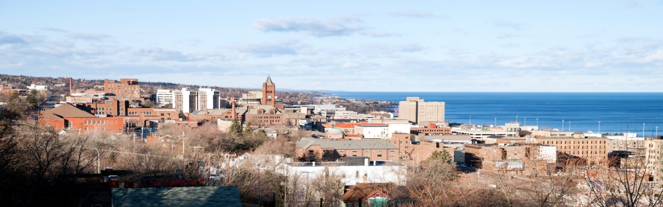
2019 Safe Harbor Evaluation Report
(Wilder Foundation)
  Total of 1,279 youth served as reported by Safe Harbor grantees from April 1, 2017 to March 31, 2019 (potential duplicates), with 977 newly enrolled clients
  222 youth identified as American Indian or Alaska Native
  Nearly 1,000 youth in the Child Welfare System (point in time)

Slide 13
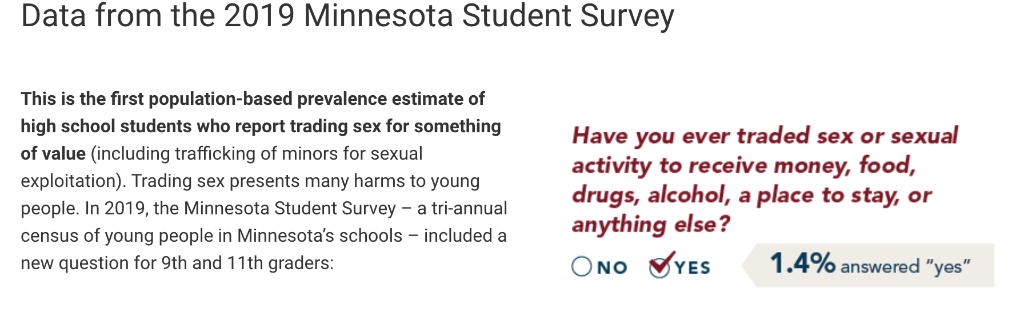
Minnesota Student Survey Data

Slide 14


Minnesota Student Survey Data

Slide 15
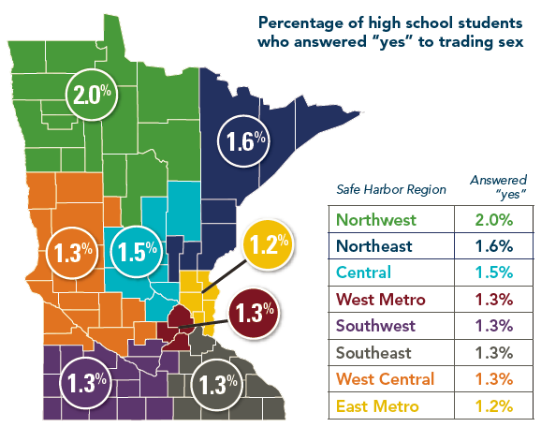
Minnesota Student Survey Data 2019

Slide 16
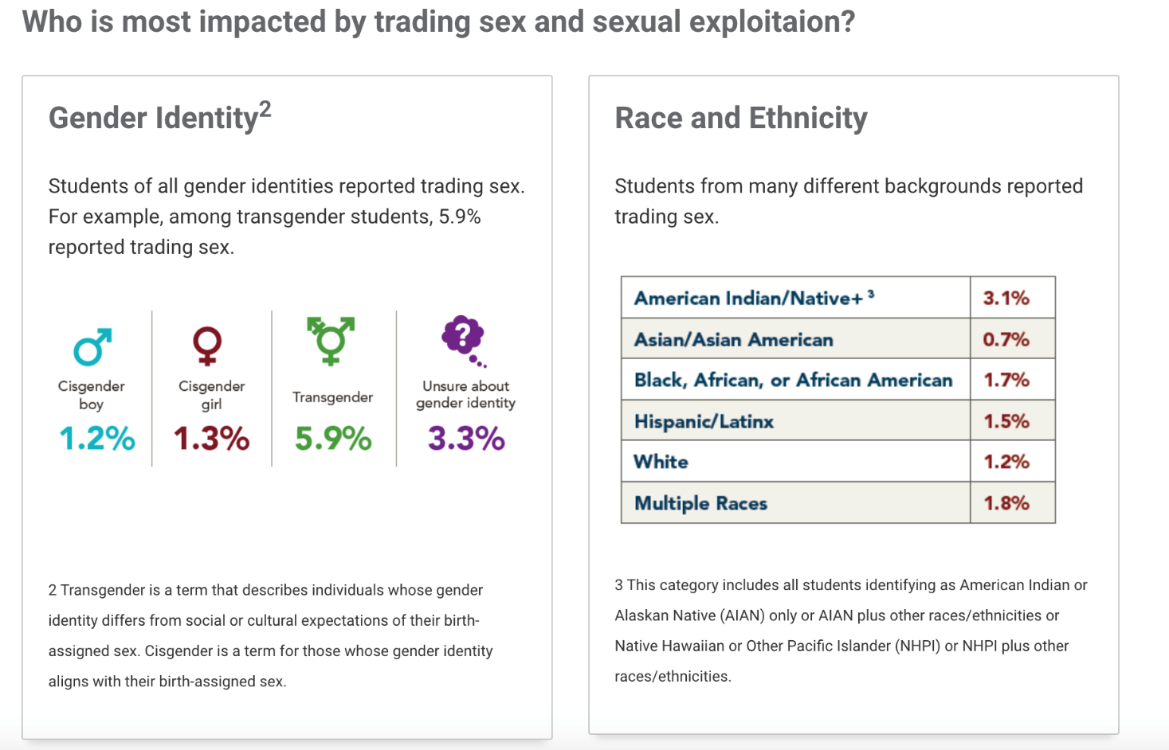
Minnesota Student Survey Data 2020

Slide 17
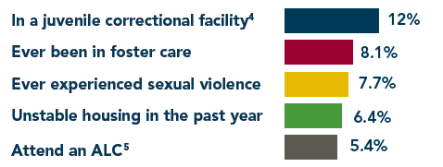
Minnesota Student Survey Data 2020

Slide 18
Minnesota Student Survey Data 2020
Minnesota Department of Health
  Beatriz Menanteau, JD, Injury & Violence Prevention Unit Supervisor
  Caroline Palmer, JD, Safe Harbor Director
University of Minnesota Research Team
  Lauren Martin, PhD - School of Nursing
  Barbara McMorris, PhD - School of Nursing
  Katie Johnston-Goodstar, PhD - School of Social Work
  Nic Rider, PhD - Medical School

Slide 19

Coming Soon: Identification Tool
Minnesota Youth Trafficking and Exploitation (MYTEI)
Ages 13-17 focus
Sex and labor trafficking identification
Online training
Resources and referrals
Survivor-informed
Broad use

Slide 20
MDH Health Care Provider Training Project
Develop guidelines for health care providers responding to human trafficking/exploitation (sex and labor)
Draw from existing national tools and approaches to build Minnesota-specific response
Start spring 2019 and complete by spring 2021
75% sought health care within past 6 months, Curtis, Terry, Dank, et al, 2008

Slide 21

MDH Health Care Provider Training Project
New ICD-10 Codes (2018) - List of diagnostic codes created by the International Classification of Diseases
Helps to differentiate human trafficking patients from other forms of abuse
Helps to track medical conditions related to trafficking to drive training and policy response
The codes cover (child and adult):
  Forced labor
  Sexual exploitation
  Human trafficking

Slide 22

Workgroup Representation
Mayo Clinic
Midwest Children’s Resource Center
Indian Health Services – Cass Lake
Family Tree Clinic
Children’s Healthcare of Atlanta
Minnesota Hospital Association
Create Impact Consulting
Breaking Free
The Enitan Story

Slide 23
Process
Guided by state-wide workgroup
Review of existing tools
Provider and survivor-informed needs assessment
Development of health care provider training

Slide 24
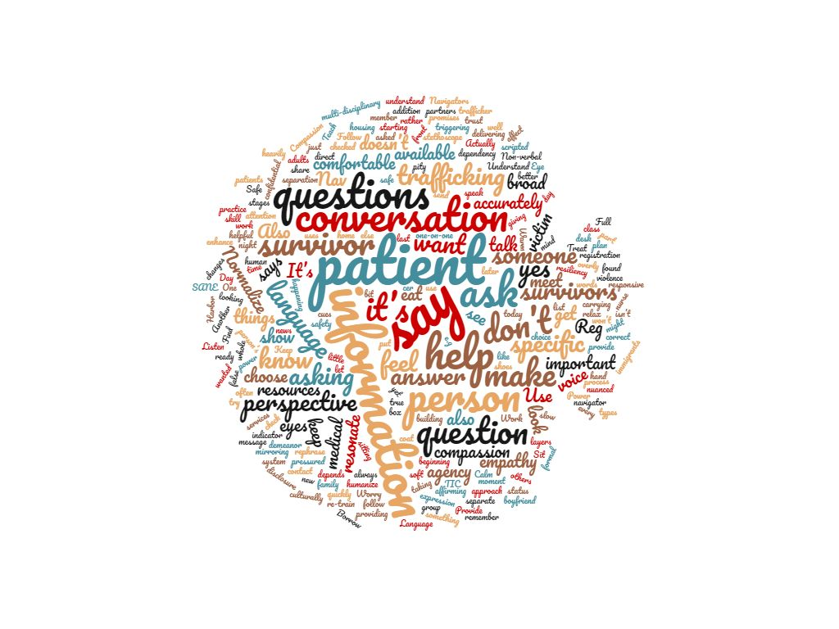
What We Learned from Survivors
Trauma-informed approaches
Expectations of health care providers
Importance of autonomy, respect, and confidentiality
Role of advocacy

Slide 25
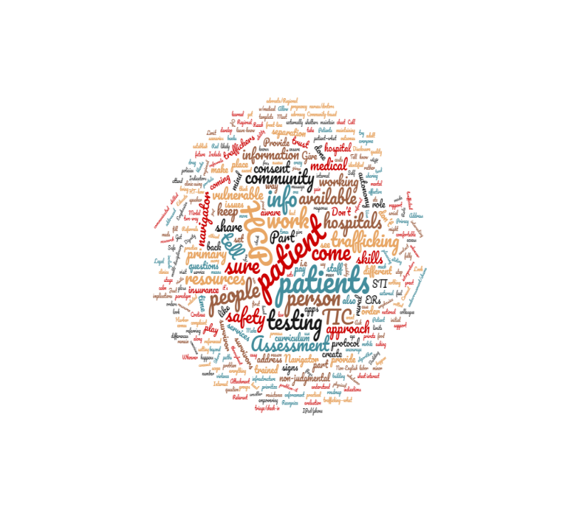
What We Learned from Survivors
Assessing
Disclosures
Discussed: ‘What is an effective medical response?’

Slide 26
Two Sections: 6 Modules
Section 1: Human Trafficking and Exploitation
Overview and dynamics
Indicators of trafficking and exploitation
Assessment with possible questions
Section 2: Health Care Provider Response, Referral, and Coding
Survivor informed response for the health care provider
Safe Harbor services, resources, and considerations
Diagnostic codes
Notes:
Caroline or Leah

Slide 27

Module 1: Overview and Dynamics
Definitions: Sex and Labor Trafficking (Minnesota, Federal Definition, and Tribal Codes) Minnesota Approach Incidence/Prevalence Settings where trafficking occurs Public health concern Recruitment of victims Tactics
Notes:
Leah

Slide 28

Module 2: Indicators of Trafficking and Exploitation
Vulnerable groups Red flags Indicators
Notes:
Caroline

Slide 29

Module 3: Assessment and Questions to Consider
Possible questions to consider Physical assessment
Notes:
Leah

Slide 30

Module 4: Survivor Informed Responses for the Health Care Provider
Addressing primary health concern Practical aspects of the visit Trauma-Informed approach Patient rights-based approach
Notes:
Caroline

Slide 31
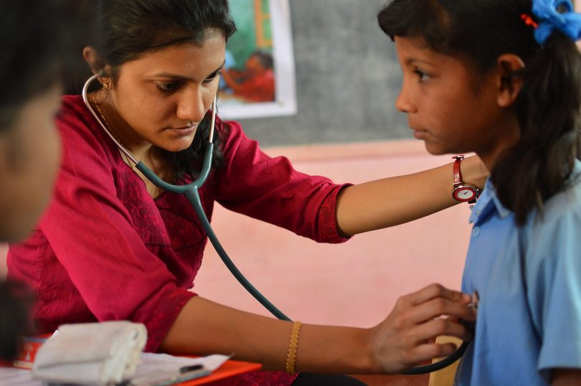
Module 5: Safe Harbor Services, Resources, and Considerations
Safe Harbor services and explanations Community based services Considerations when offering referrals Interaction with patient
Notes:
Leah

Slide 32

Module 6: Diagnostic Codes and Considerations
Explanation of codes and how to use Benefits of coding Coding considerations Practice and policy considerations
Notes:
Caroline

Slide 33

Next Steps
Transfer materials to online training modules
Review with original workgroup and additional stakeholders
Expand partnerships to distribute training awareness and access

Slide 34

What are your questions?

Slide 35

Thank you!

Slide 36

Contact us!
Caroline Palmer, JD
651.201.5452
caroline.palmer@state.mn.us
MDH Safe Harbor info: https://www.health.state.mn.us/communities/safeharbor/
Leah Lutz
763.229.7133
leahlutzconsulting@gmail.com

